Slide 1
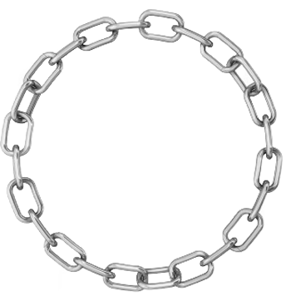
The South Toronto LINK Team
HSJCC Presentation
March 05, 2015

Slide 2
LINK Team Members
Deryck Thomas – Program Manager
Dr. David Kantor – Psychiatrist
Mike Hughes – Team Lead/Care Coordinator
Tobie Marven – Care Coordinator
Cathie Simpson – Nurse Practitioner
Bethel Lascano – Nurse/Case Manager
Jennifer Carandang – Nurse/Case Manager
Bruce Peachey – Nurse/Case Manager
Miranda Maracle – Nurse/Case Manager
Shannon Barley – Behaviour Therapist
John Curtinhas – Behaviour Therapist
Paul Godfrey – Case Manager
Gregory Keefe – Case Manager
Libia Pelaez – Administrative Support

Slide 3
Background
In September 2013, the TCLHIN convened a planning group to scope the requirements for enhancing capacity to connect complex and at-risk clients to the appropriate level of services. The goal was to increase access, improve coordination and enhance care. The Link Team provides the highest level of community-based assessment, coordination, clinical support, and multidisciplinary service to individuals age 16 and up who have the most complex mental health, addictions and comorbid health needs. These individuals are identified as the 1% of the health user population that accounts for one third of health care costs in Toronto.

Slide 4
Catchment Area
The Link Team serves individuals who live or are referred from within the South Toronto Health Link catchment area.
Yonge St. west to Kipling.
Eglinton Ave. south to Lakeshore.

Slide 5
Population Served
Frequent users of Emergency Departments, short term crisis units and impatient units. They often have a history of trauma, PTSD, medical/physical health issues, neurocognitive impairments, challenging behaviours, personality disorders and a poor track record of engagement.

Slide 6
Service Delivery
The LINK service delivery model focuses on providing services to complex clients with urgent needs. The LINK team provides:
Timely Access to Service: Creating a mechanism and capacity that will ensure the client is connected to service immediately upon referral.
Clinical Care Coordination: The role of the care coordinator is the first critical feature of the LINK team process. Collateral information is collected, meeting with clients and other service providers is arranged and a LOCUS assessment is completed to determine the appropriate level of service required. This assessment of need, provides the framework to develop the treatment/care plan and key accountability for mobilization of resources to be provided to client.

Slide 7
Integrated Multi-disciplinary Team Approach
The LINK team ensures that a continuum of integrated services is available to meet the immediate and changing service requirements of each LINK client. The LINK team is comprised of a Psychiatrist, Nurse Practitioner, Social Workers, Nurses, Behaviour Therapists , Clinical Care Coordinators, Case Managers and PSW support staff.

Slide 8
Additional LINK Support
The LINK team has been trained in Dialectical Behavioural Therapy (DBT)
Each client has access to one to one DBT support.
Additional support is provided through a weekly DBT skills group.
LINK also has a 24/7 coaching line that clients can access for additional support after regular business hours.

Slide 9
Quick Overview
Referral LINK Received
Assigned to a Care Coordinator/ collection of collateral information/meeting with client and other service providers. LOCUS assessment conducted to determine the appropriate level of services/support. Care plan initiated. Assignment to primary worker within LINK or other RMHS programs.
In-depth weekly review of each clients ongoing service/support requirements is conducted. Continuous inter-disciplinary consults occur to ensure that any gaps in services/care plans are identified and addressed immediately.

Slide 10
Benefits of this Approach
Single source of community based access for complex care.
Clients will have access to a single source health service provider with the full spectrum of services based on level of care required (one-stop shopping).
Reduced fragmentation and administrative burden usually associated with networked models of care.
Addresses significant gaps in the current service arrangements.
Different, innovative, practiced informed and economical.

Slide 11
Current Numbers
To date we have had 123 referrals
80 Enrolled in LINK
58 assigned to LINK case managers
22 currently in care coordination

