Slide 1

Factors Influencing Mental Health and Criminal Justice Involvement
Human Services and Justice Coordinating Committee Conference
November 18, 2015
Uppala Chandrasekera
Director, Public Policy, Canadian Mental Health Association, Ontario Division
Frank Sirotich
Director, Community Support & Research, Canadian Mental Health Association, Toronto Branch
Ryan Fritsch
Lead, Mental Health Strategy, Legal Aid Ontario
Michael Dunn
Co-Chair, Provincial Human Services and Justice Coordinating Committee

Slide 2
Agenda
Introductions
Understanding the Social Determinants of Health (SDoH)
  Impact of SDoH on mental health and addictions
  Impact of SDoH on justice involvement
How Mental Health & Addictions Sector is addressing SDoH
How Justice Sector is addressing SDoH
Cross-Sector collaborations to address SDoH
Q & A

Slide 3
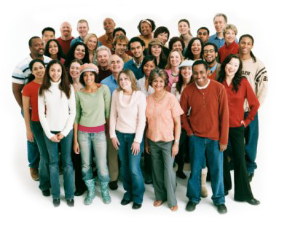
Mental Health Affects Us All
One in three Canadians experience a mental health issue within their lifetime
Currently more than 6.7 million people are living with a mental health condition in Canada
More than 28% of people aged 20-29 experience a mental illness in a given year

Slide 4
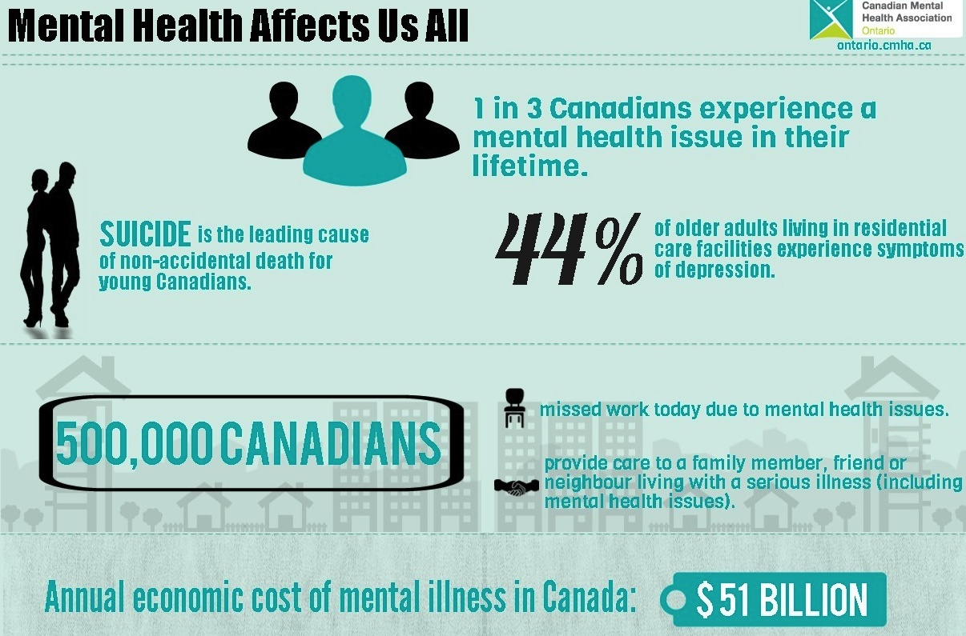

Slide 5

Mental Health Affects Us All
Economic cost to Canada is at least $50 billion per year, which represents 2.8% of Canada’s 2011 GDP
Cost to businesses in 2011 was $6 billion in lost productivity
$1.4 billion each year in costs to the health care, justice and social services systems

Slide 7
Defining Mental Health
In the Health Care context
In the Justice context
Mental health is the capacity of each and all of us to feel, think, and act in ways that enhance our ability to enjoy life and deal with the challenges we face.
It is a positive sense of emotional and spiritual well-being that respects the importance of culture, equity, social justice, interconnections and personal dignity
Criminal Code of Canada uses term mental disorder to mean
“a disease of the mind”
This definition is used in rare cases that recognizes mental health conditions to the extent that they have an impact on criminal responsibility

Slide 8
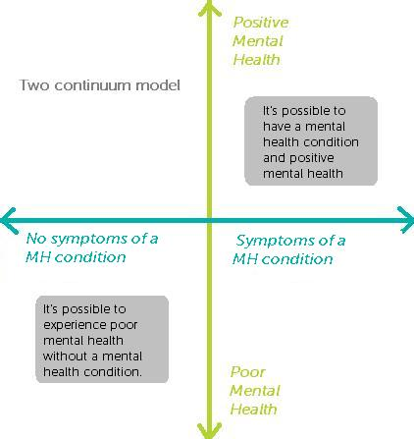
Notes:
Two continuum model presents two dimensions of MH
One continuum for presence/absence of symptoms or diagnosis
One for poor to positive mental health
Mental health is not fixed
A person with a MH condition can experience positive mental health
A person without a condition can experience poor MH

Slide 9

Life Stressors Affect Our Mental Health
Life stressors are the events in a person’s life that bring about significant anxiety and stress
Stress is caused by negative and unpleasant life events, such as the death of loved one,
loss of a job or divorce
Positive and pleasant life changes
may also cause significant anxiety,
such as marriage, pregnancy,
and a change in career

Slide 10



Social Determinants of Health
The social determinants of health are broadly defined as the economic and social conditions that influence the health of individuals and communities.
Dennis Raphael, 2004

Slide 11
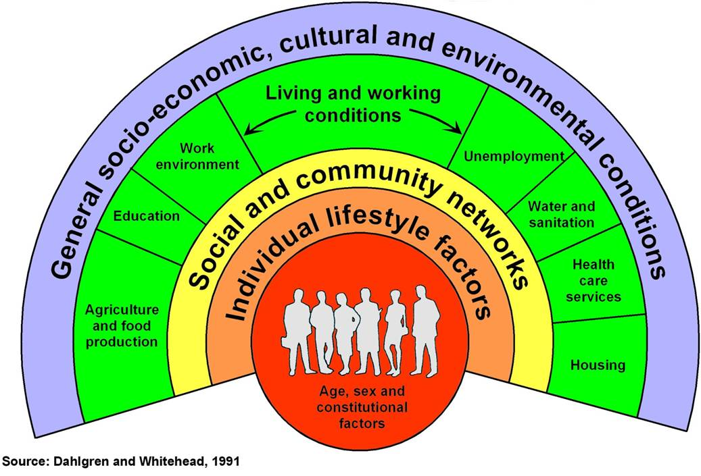
Social Determinants of Health

Slide 12
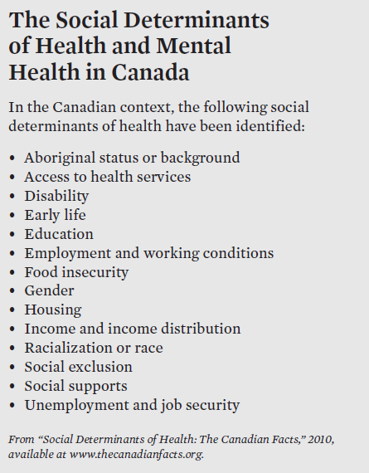

Slide 13
Key question:
What are the main factors that influence mental health as well as involvement in the criminal justice system?

Slide 14
Income & Employment
Impact on Mental Health
Impact on Justice Involvement
Unemployment and a stressful or unsafe workplace have been associated with poor health outcomes
Episodic nature of mental health issues can also make job retention a challenge
Poverty and lack of career options and opportunities in the workforce can lead to immediate risk factors for involvement in criminal activities
Individuals that have a history of legal involvement are more likely to be receiving social assistance

Slide 15
Housing & Homelessness
Impact on Mental Health
Impact on Justice Involvement
Adequate, suitable, and affordable housing contributes to individual mental well-being, leads to increased personal safety and helps decrease stress
High housing costs and living in poor housing creates stress,
may result in unhealthy ways of coping
Homelessness and the availability of housing have an impact on whether individuals come into contact with the criminal justice system
Living in a poor neighbourhood and in poor housing conditions are also risk factors for criminal activity

Slide 16
Education
Impact on Mental Health
Impact on Justice Involvement
Obtaining education increases overall literacy, improving people’s ability to access and understand information to keep them healthy
Episodic nature of mental health issues can interrupt education and result in reduced opportunities to acquire employment in the long term
Level of education and school experience one has can influence involvement in the justice system
Interactions with peers at school, low school engagement and attendance, low academic performance, disruptive behaviour, bullying are all risk factors for criminal activity

Slide 17
Looking at Stigma and Discrimination
Stigma is the negative attitude based on assumptions, misperceptions and stereotypes.
Overt discrimination often takes the form of individual acts of differential treatment of one person by another.
Covert discrimination or systemic discrimination is often invisible and embedded into institutions and society at large, and serves to exclude or impose restrictions upon groups of individuals.

Slide 18
Discrimination
Impact on Mental Health
Impact on Justice Involvement
Discrimination can lead to chronic stress in individuals
High stress levels can lead to chronic conditions including mental health issues as well as unhealthy coping strategies
Both youth and adult racialized and Aboriginal people are over-represented in the criminal justice system
Despite Aboriginal people making up appox. 4% of the Canadian adult population and 7% of the youth population, they accounted for over 28% and about 39% of admissions to correctional facilities respectively in 2011/2012

Slide 19
Social Inclusion
Impact on Mental Health
Impact on Justice Involvement
Exclusion of individuals and communities from society results in a range of chronic conditions
Those who report excellent or very good mental health are more likely to report a very strong sense of community belonging
Sense of exclusion can lead to feelings of isolation, impulsivity, and a lack of belonging, all of which are risk factors for engaging in criminal activity

Slide 20
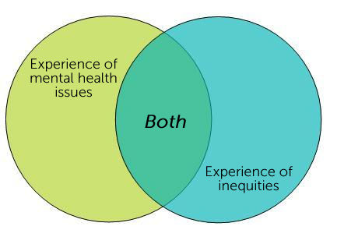
Who is impacted?
3 population clusters emerge:
Notes:
Through these examples, three priority population clusters become clear: PWLE, other marginalized populations, and PWLE experiencing additional marginalization. Based on the key concepts, informant interviews and review of literature
Clusters because not just one population, but groupings of them.

Slide 21

How can we help?
Encourage continued integration between the mental health and criminal justice systems in addressing the social determinants of health
Leverage existing expertise and promising practices
Foster formal and information partnerships between police services, lawyers, courts, correctional facilities and community mental health and addictions services, hospitals and other social services

Slide 22
How MH&A Sector Addressing SDoH
Emerging programs and strategies:
IPS Supported Employment
Housing First & MHJ Safebeds
Supported Education
Strategies to Address Institutional Discrimination
Peer Support & Service User Engagement

Slide 23
Supported Employment
Individualized Placement & Support (IPS):
  Employment specialists integrated with treatment teams, provide full range of supported employment services
  Shift from “train-place” to “place-train” approach
  Minimal preliminary assessments, rapid job searches, normal work settings, match clients with jobs of their choice, and ongoing support
  Staff training manual, fidelity scale used
  Strongest empirical support of any model of vocational services

Slide 24
Supportive Housing
Housing First Model
  Moves homeless individuals immediately from streets/shelters into own apt, with wrap around supports (e.g. ICM/ACTT)
  Shift from “housing readiness” model
  Continued tenancy not dependent on participation in services
  Strong empirical support: increased housing tenure, reduce ED/inpatient use, criminal justice involvement
  Fidelity measures available

Slide 25
Residential Crisis Beds
Mental Health and Justice Crisis Beds (Safebeds)
  Short-term emergency and transitional housing for individuals with current criminal justice involvement or transitioning from correctional/detention setting
  Crisis support staff onsite 24/7
  Enabling linkage to longer term support services (ICM/pre-charge diversion programs)
  No research as yet on program efficacy

Slide 26
Supported Education
Program/services that assist individuals to gain access to and complete postsecondary education
Three models:
  Self-contained class room
  Onsite support
  Mobile Support
Paucity of research; early findings indicate: greater retention/completion, decreased hospitalizations; improved job opportunities
No difference in outcomes between models

Slide 27
Addressing Institutionalized Discrimination
Relative dearth of high quality research to inform service development; recommendations include:
Population-based, flexible services (e.g. services specific to ethno-cultural, racialized, newcomer communities)
Indigenous directed health services
Attract more diverse workforce at all levels of organization
Interpretation services (phone or in-person)
Cultural competence/cultural safety training
Trauma-informed care, which takes up intergenerational trauma

Slide 28
Peer Support & Service User Engagement
Support provided by peers, for peers; or any organized support provided by and for people with mental health problems.
Different approaches:
  Informal grassroots self help groups by volunteers
  Independent peer run organizations
  Peer support programs within mainstream agencies
  Peer support workers employ by mainstream services
Research shows:
  Improved QoL, social support
  Reduced symptom distress, hospitalizations

Slide 29

Mental Health Strategy @ LAO
Mid 2012: LAO’s Board of Directors approved development of a Mental Health Strategy (MHS) with a five-year mandate
Early 2013: Work on the MHS began
The objectives of the Strategy:
  Scope Review all LAO services and mandate through a mental health lens
  Study How does MH&A intersect with LAO?
  Sequence Set strategic goals and specific yearly initiatives
  Stakeholders Involve stakeholders in the initial and ongoing development of the strategy, and in new partnership initiatives

Slide 30
Mental Health Strategy @ LAO
First-half 2014: Province-wide consultations took place: 24+ in-person consult sessions; 2500+ downloads of paper; 65+ written submissions
Key theme across all providers and stakeholders: lawyers need MH training to provide more effective advocacy
Early 2014: Partnership established with Mental Health Commission of Canada
August 2014: External Training Advisory Committee convened. Membership includes academics, private bar, staff lawyers, clinic lawyers, clients, and MH service providers

Slide 31
Training Needs of Advocates
Independence: what is the relationship between rights and mental health issues? What is the role of an advocate?
Understanding: how can an advocate identify client abilities, needs and options beyond simplistic proxy labels or diagnoses? How can an initial point of contact unpack multiple and intersecting legal issues?
Practical “mental health first aid”: communication skills, understanding illnesses, anti-oppression and trauma-informed, service options
Effective advice: takes into account secondary consequences; bail and diversion terms that setup clients to fail; social and health factors which contribute to recidivism;
Communities of Practice: ongoing support, mentorship and second chair opportunities, practitioner wellness and self-care
Locality: Every court and community has different practices and services

Slide 32
Training Outcomes for LAO
Demonstrate an effective, province-wide legal aid response to federal and provincial MH strategies
A framework for quality assurance, higher qualification standards, and enforceable practice standards
Modernize key performance indicators, better measure outcomes, and better identify client needs
Recognize and qualify expert practitioners & reward dedication with, for example, appellate level work
Recognition of legal aid as a critical mental health rights advocacy organization in Ontario
Greater confidence and job satisfaction for practitioners
Greater willingness of practitioners to work with MH clients – increasing systemic capacity and anticipating growth

Slide 33
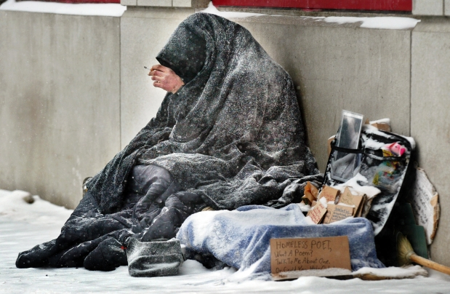

Slide 35
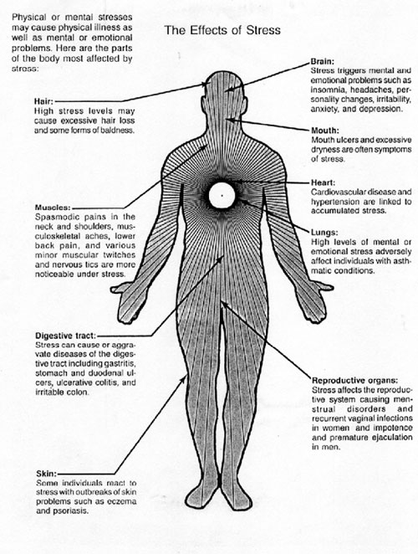


Slide 36

To provide a planning table to bring together service providers to find solutions to the problem of the criminalization of people with defined unique needs, and;
To develop a model of shared responsibility and accountability in dealing with this group of individuals at points of intersection with the justice system

Slide 38
Some Examples
Advocacy
Affordable & Accessible Housing
Transitional Housing (Safe-Beds)
Police Records Check Reform
Prisoner Belongings
Strategies for Engaging with Corrections

Slide 39
Some Examples
Collaboration
Working with Police: CIT, MH Strategy
Situation Tables
Specialized Court Projects
Education, Conferences (like this..) and Webinars

Slide 40
Local Examples
46% working on transportation issues
20% involved in advocacy: transit, awareness events, supporting other initiatives
68% held training sessions (CIT, MH First Aid)
Bail support programs
TRHP Programs
COAST Programs

Slide 41


Slide 42
I guess what I’m trying to say is....
Starts with recognition of the link between SDoH and health and justice
Use common language (paper)
Build relationships
Support the practices that work
Think local first
Collaborate
Be the spark that ignites the flame
“The first resistance to social change is to say it’s not necessary.”
- Gloria Steinem

Slide 43
Contact Us
Uppala Chandrasekera
uchandrasekera@ontario.cmha.ca
Frank Sirotich
fsirotich@cmha-toronto.net
Ryan Fritsch
fritschr@lao.on.ca
Michael Dunn
mdunn@cmhastarttalking.ca

