Slide 1

Mental Health Diversion
Canadian Mental Health Association Lambton Kent Branch
Notes:
Almost all jail inmates will leave correctional settings and return to the community. Inadequate transition planning puts jail inmates, who entered the jail in a state of crisis, back on the streets in the middle of the same crisis. The outcomes of inadequate transition planning include the compromise of public safety, increased disability secondary to health and behavioral health symptoms, hospitalization, suicide, homelessness, new criminal offenses, and rearrest. With the majority of inmates being released within a very short period of time, often without notice, jails present unique challenges to transition planning.

Slide 2
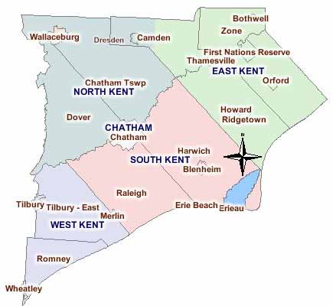

Chatham-Kent

Slide 3

Mental and Justice Program Goals
To serve as access and coordination points for the social service and criminal justice systems
To help prevent/reduce the involvement of persons with mental health in the criminal justice system.
Notes:
Other goals of the program include:
-To ensure individuals with mental illness who are in conflict with the law can find support and transition into their chosen community
-To coordinate community supports
-To reduce recidivism by ensuring the consumer has the community supports and treatment options in the community thus reducing institutional costs
-To assist clinical and other correctional staff by providing information and access to community resources
-To form/review linkages with crisis teams and other service providers
-To advocate to communities institutions corrections and families for the rights of the mentally ill who have been incarcerated so that they receive the support and services that facilitates them to live the highest standard of life achievable

Slide 4

Court Support Services
Court support worker will provide support to individuals involved in the court system experiencing mental health symptoms
  Can assist with Mental Health Diversion if person meets criteria (provided in later slides)
  provide support and information for family members and/or significant others
  Linkage to community supports
  Consultation to individuals, police, legal personnel
  Assistance with Form 2 applications
Notes:
Services include: initial assessment, assertive outreach and linkage, referrals, advocacy, education, goal development

Slide 5

Release from Custody Services
Release from Custody worker provides short term (3 months), intensive case management services to individuals with a diagnosed MMI or SMI who are being released from custody
  facilitates a stable transition back to the community
  Linkages to longer term case management services, rehabilitative programs/medical treatment
  Consultation with individuals, police, legal personnel
  Provides a central point of contact for individuals to access/be referred to mental health services and other required supports; coordinates a continuum of services based on client choice and need
Notes:
Services include: initial assessment, housing, financial support, medical and psychiatrist services, medication and one on one support, referrals. The model identifies four sets of tasks that are required in the jail transition process. While originally conceived as specific to inmates with co-occurring mental health and addictive disorders, the tasks have been identified as relevant to the entire jail population.
The goals of the assessment process within jail settings are to: collect as much relevant information as possible, as early as possible; use validated screening tools and measures whenever possible; conduct in-depth assessments on identified areas of need as time permits; record all collected information in a manner that makes it readily accessible to those who need to know (including inmates) both during incarceration, upon release, and upon possible future re-arrests; update information that is dynamic (subject to change) at regular intervals; and reassess the inmate prior to release.
Planning - Given the time-limited nature of most jail stays, plans for how to address identified social, legal, and health needs of the arrested population must begin before individuals are booked. Understanding the profile of the local communities arrested population allows reentry collaborators to anticipate generic needs of arrestees. Typical issues confronting the jail reentry coordinating group include: housing, health care, substance abuse and mental health issues, and income
Identify - identify how, where, when, and with whom these needs will be addressed. Specific community referrals to implement the inmate’s plan must be developed.
Coordinate - Inmates typically have multiple needs and upon release are often put in a position of juggling competing priorities. Fragmented systems of care make coordination and implementation of transition plans challenging for individuals who may have significant disabilities. Access to case management services is a critical component of successful reentry efforts (Dvoskin and Steadman 1994) and case management strategies to reduce recidivism and address critical health issues have been applied in many jurisdictions

Slide 6


Referrals can be made by:
Other CMHA workers or programs
The consumer
The consumer’s family or peers
Lawyers
Correctional Facilities
Ontario Works/ODSP
Probation/Parole
Police Services
Other social service agencies

Slide 7

Mental Health Diversion Program Criteria
Be 16 years of age or over
Is a resident of the Chatham Kent area or moving back to an address in this area
Has been charged with an eligible criminal offence under the criminal code of Canada
  Class 3 offences are never eligible for mental health diversion
Notes:
People living with mental illness or developmental disability may access alternatives to criminal prosecution. This process is known as the mental health diversion. If the Crown Attorney believes that symptoms of mental illness are related to the criminal activity, he or she may determine that mental health diversion is an appropriate option for disposition. The decision about eligibility will depend upon the Crown Attorney’s assessment of: the circumstances of the offence; the circumstances of the accused; the needs of the community including the victim

Slide 8
Process
Court support worker refers to mobile PAN for pre-assessment and then appointment with psychiatrist booked
Risk assessment and recommendations provided to crown
Court worker creates diversion plan to present to Crown
Diversion plans last approximately 1 year

Slide 9
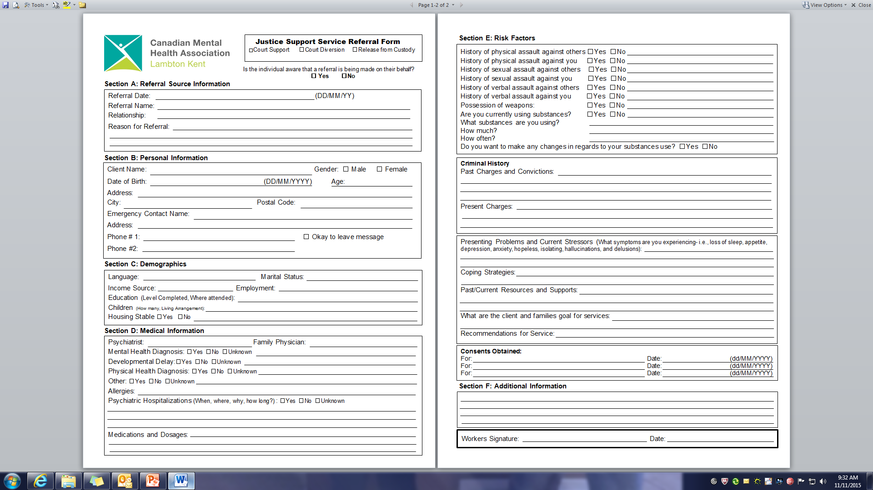
Justice Referral Form

Slide 10
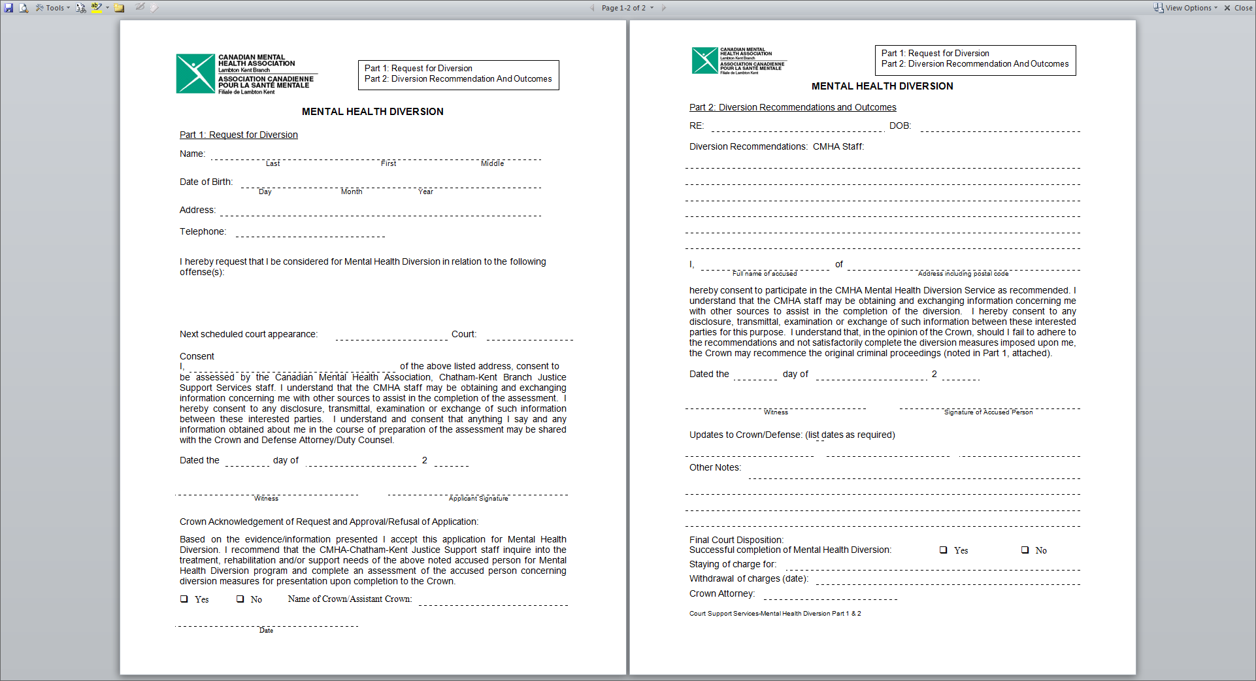
Diversion Paperwork

Slide 11

Possible Outcomes
Stay of proceedings
Peace bond
Withdrawal of charges

Slide 12
Case Study
Diversion #1
  21 year old male
  Diagnosis: schizophrenia
  Charges: assault
  Currently in progress

Slide 13
Case Study Continued
Diversion #2
  54 year old female
  Bipolar
  Charges: theft under $5000; possession of stolen property under $5000; flight from a police officer
  Successfully completed

Slide 14

Measure of Success
Clients spend less time in custody
Reduced numbers of mentally ill incarcerated
Increase awareness, knowledge and skills in community, courts, institutions and correctional services to recognize and support the client
To reduce numbers of mentally ill in contact with hospitals, police, and courts
Reduced rate of recidivism
Notes:
For the large portion of individuals who will quickly, and often unpredictably, be released, the task is to send them out with as much useful information specific to their needs and circumstances as possible.

Slide 15

QUESTIONS???

