Slide 1
A Multiservice Agency
October 2016

Slide 2

2

Slide 3
Board of Directors
President | Marc-André Massie
Vice-President | Gilles Clavelle
Secretary | Louise Lepage-Gareau
Treasurer | Pierre Saumure
Past President | Michel Nault
Directors | Len Bastien
 | Gabrielle Cadieux
 | Paul Cadieux
 | Cynthia Desjardins
 | Rachelle Laforge
 | Julien Martel
3

Slide 4
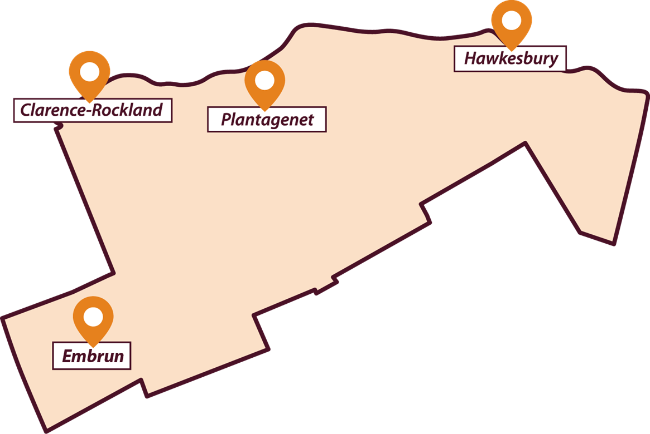



Head Office
PRESCOTT-RUSSELL
1
DAY CENTRES
RESIDENTIAL SERVICES
RESPITE HOME
Notes:
Être au cœur de la communauté et offrir des services en lien avec les besoins de celle-ci.
Être plus accessible à M. et Mme Tout-le-Monde.
Réaliser l’intégration sociale par l’intégration de nos services dans les communautés.
Développer des partenariats avec d’autres partenaires communautaires.

Slide 5
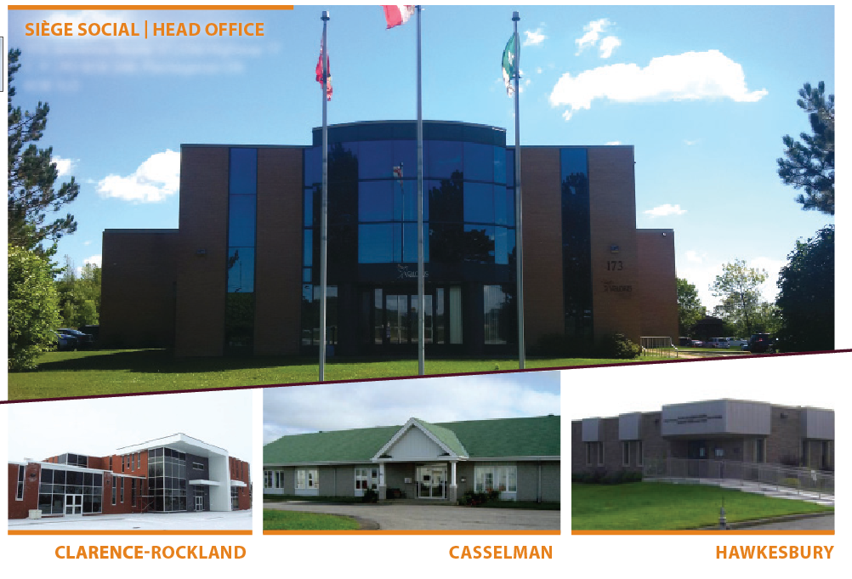
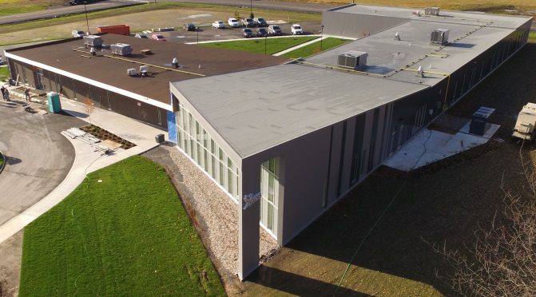
EMBRUN

Slide 6





5 Service Mandates
Child and Family Mental Health
0 to 18 years
Child Developmental Services
0 to 18 years
Child Welfare
0 to 21 years
Adult Developmental Services
18 + years
Family Violence
16 + years
*Valoris is also the lead agency for children and
youth mental health services in Prescott-Russell.
6

Slide 7

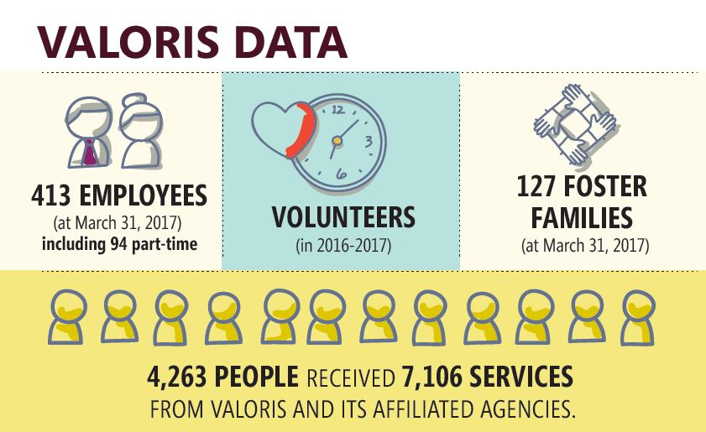
2016-2017

Slide 8
Our agency
Innovator and leader in developing new approaches such as:
    Communities That Care
    Looking After Children
    Triple P (Positive Parenting Practice)
    FIT (Feedback Informed Treatment)
    Gentle Teaching
Strong financial management and good financial condition.
Many community partners in Prescott-Russell and across Ontario.
Leader in French language social services.

Slide 9
Social Role Valorization

Slide 10

Budget 2016-2017

Slide 11



Our related agencies
Social enterprises
Professional and Community
Developmental Services
Fundraising and property management
11

Slide 12


