Slide 1
By: Dr. Samim Hasham BSc.Pharm (Hons), MMngt, CDE, PharmD, BCMAS (c)
WEST - HSJCC
October 17th , 2017

Slide 2
Disclosures : Mental Health Related Expert Reviews / Presentations
Centre for Effective Practice
CPhA
McKesson Canada
EPICON
OPA
Commonwealth Pharmacists Association
…………

Slide 3
Understanding basic medication-related issues in clients with common psychiatric conditions:
A primer for individuals working
within the justice system
with specific focus on:
street drugs
antipsychotic medications
antidepressants
mood stabilizers

Slide 4
Which second generation antipsychotics (SGA) lead to the most weight gain?
Olanzapine and Quetiapine
Risperidone
Aripiprazol and Ziprasidone
Haloperidol and Fluphenazine
Which tests are recommended by the Canadian Diabetes Association guidelines for SGAs?
Lipid Panel
Fasting Blood Sugar
BMI
All the above
4. Can you name at least 4 neurotransmitters?
5. Can you name 5 street / party drugs ?
6. Fluoxetine is a(n)
a) antidepressant
b) Mood stabilizer
c) Antipsychotic
d) None of the above

Slide 5
Brain Chemicals
Dopamine
a feel good chemical
Serotonin
the happy, anti-worry, flexibility chemical
GaBA
an inhibitory neurotransmitter that helps calm or relax the brain
Endorphins
the brain’s own natural pleasure and pain killing chemical
Glutamate
locks the pleasurable experience into memory

Slide 6
Drugs and Neurotransmitters
Dopamine – amphetamines, cocaine, ETOH
Serotonin – LSD, ETOH
GABA – benzo’s and ETOH
Endorphins – opiods, ETOH
Glutamate – ETOH
AcH – nicotine, ETOH
ENCB – marijuana, ETOH

Slide 7
PUTTING IT ALL TOGETHER
Neurotransmitters
RELATED DRUGS
Dopamine
a feel good chemical
Serotonin
the happy, anti-worry, flexibility chemical
GaBA
an inhibitory neurotransmitter that helps calm or relax the brain
Endorphins
the brain’s own natural pleasure and pain killing chemical
Glutamate
locks the pleasurable experience into memory
Dopamine – amphetamines, cocaine, ETOH
Serotonin – LSD, ETOH
GABA – benzo’s and ETOH
Endorphins – opiods, ETOH
Glutamate – ETOH
AcH – nicotine, ETOH
ENCB – marijuana, ETOH

Slide 8
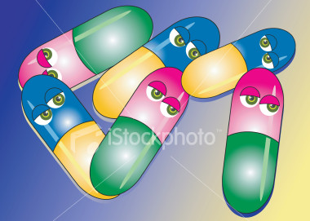
What is a Drug?
A DRUG IS ANY SUBSTANCE OTHER
THAN FOOD WHICH CHANGES THE
WAY THE BODY OR MIND FUNCTIONS

Slide 9
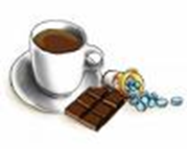
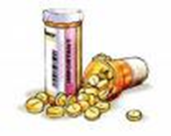
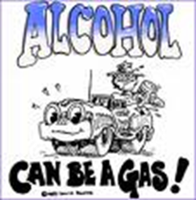
Types of Drugs
Stimulants (uppers)
Speed up the brain and central nervous system
caffeine (coffee, tea) nicotine (cigarettes), amphetamines, speed, cocaine and diet pills.
Depressants (downers)
Slow down the brain and central nervous system
alcohol, beer, wine, vodka, gin etc heroin, tranquilizers, sleeping pills.

Slide 10
Types of Drugs
Hallucinogens
Alter the user’s state of consciousness.
Distort auditory and visual sensations
LSD, ecstasy, magic mushrooms, marijuana.

Slide 11
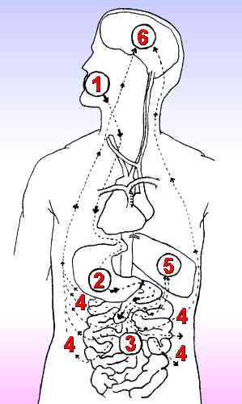
Alcohol
Alcohol
Spreads evenly throughout body
except brain which gets the highest concentration
gets more blood than any other part of body
More blood equals more alcohol
Intoxication (drunkenness) starts in the brain

Slide 12
Alcohol
Physical Effects
Co-ordination is impaired, clumsiness, slower reflexes
High BP, damage to the heart
Liver damage
If drinking when pregnant, FASD
Life threatening when mixed with other drugs
Mental and Emotional
Behave in ways that one normally wouldn’t
Increase in aggressive and violent behaviour
Problems with school and learning

Slide 13
Alcohol
Oldest and most widely used drug in the world.
About two-thirds of Grade 6 students say they have experimented with alcohol.
By Grade 10, over 90% of young Canadians have tried it.
Leading cause of death for teens and young adults in Canada is motor vehicle accidents-many of which involve alcohol use.

Slide 14
Nicotine - Most addictive drug
Causes more long term health problems than any other drug
Adults are smoking less but < 18 smoke more
When someone stops smoking they have:
strong cravings
irritability (everything gets on nerves)
thoughts of it-can’t stop thinking about it
What it does to your body, brain and behavior:
Depression, lung cancer, lung diseases, heart disease, skin becomes thinner and wrinkled

Slide 15
Schizophrenia & Smoking
Smoking rate in general population: 25-30%
Smoking rate with schizophrenia: 70-90%
nicotinic receptors in brain are somehow related to both the disorder and to the pharmacology of some antipsychotics
Reduces sensory gating deficits transiently and may improve attention
Enhances acetylcholine release; may help memory, EPS
Smoking decreases sedation and orthostatic hypotension
EPS & TD rates may be higher in smokers

Slide 16
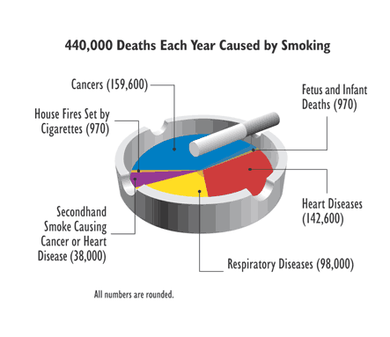
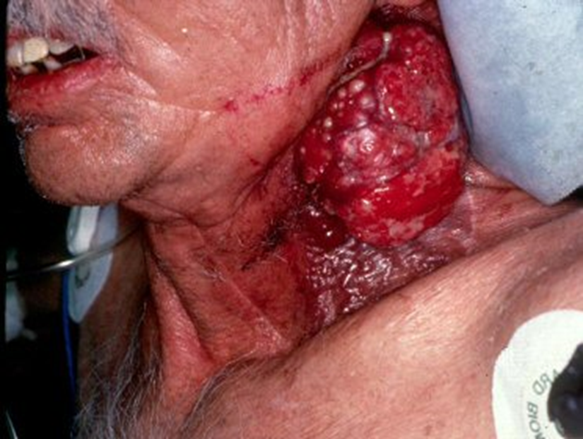
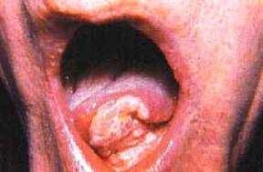

Slide 17
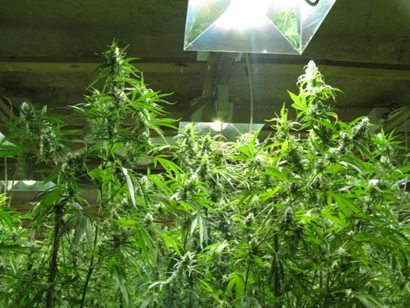
Marijuana
Most common illegal drug around
Comes from a plant called “cannabis”
Names
pot, weed, grass, hash, smoke , ganja
Has chemical “tetrahydrocannabinol” or THC
Smoke a joint :
THC goes into the lungs, then into the heart which pumps into the bloodstream which takes it directly to brain
Only takes few minutes for THC to get to brain when you smoke marijuana
Eating takes longer to get to brain-passes through digestive system first
In brain, activates “receptors” gives you the feeling of being high
Marijuana changes physical and chemical balance in your brain

Slide 18
Marijuana
Short Term Effects:
Increase in heart rate, lead to anxiety and paranoia
Distorted concept of time and space
Decrease in concentration skills, short-term memory capacity
Feeling tired after the “high” wears off
Increase in appetite, weight gain
Long Term Effects:
Breathing problems
Lung cancer
Damage cells and tissues in the body that fight disease
Lack of motivation
Difficulty processing new information

Slide 19
Marijuana – FYI
Marijuana and cigarette smoke have some of the same cancer-causing substances.
Benzopyrene (cancer-producing agent) higher in marijuana
400 chemicals in marijuana smoke affect lungs, throat and esophagus
Physical Effect
Agonist for anadamide that binds to CB1 cannabinoid receptor
Cannabinoid receptors are very widely distributed in brain
Dopamine influenced indirectly
DA neurons don’t have CB1 receptors so THC does not cause less DA release
GABA neurons normally inhibit DA
GABA neurons have CB1 receptors and become less active
More DA because THC inhibits GABA which inhibits DA
Withdrawal
Anger, Depression, Headaches, Insomnia & vivid dreams, Night sweats

Slide 20
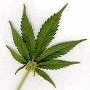
Schizophrenia and Cannabis
Hallucinogen
mimics some symptoms of schizophrenia (hallucinations, delusions, anxiety, depersonalization, paranoia)
impaired motor coordination, confusion, restlessness, and memory loss
decrease the effectiveness of the antipsychotic drugs and increase relapse
Notes:
HYPOTENSION with

Slide 21
Cannabis - THC vs. CBD
THC is the main psychoactive chemical
associated with the soaring, clear, “cerebral” high of the cannabis trip
CBD is responsible for its sedative qualities
is thought to be a cause of the heavy, stony, lethargic “body buzz”
Cannabis potency should not be judged by THC content alone but rather the THC/CBD ratio

Slide 22
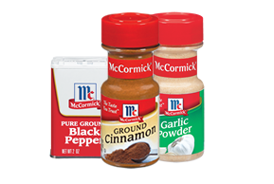
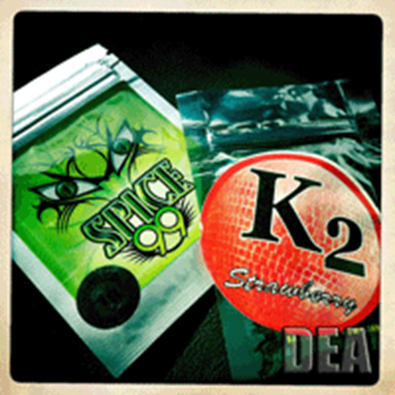
Synthetic Cannabinoids – K2 & Spice
man-made mind-altering chemicals that are either sprayed on dried, shredded plant material so they can be smoked (herbal incense) or sold as liquids to be vaporized and inhaled in e-cigarettes and other devices (liquid incense). National Institute of Drug Abuse

Slide 23
Inhalants
Attract younger children, or adults who can’t afford alcohol or street drugs
Associated with poverty, history of child abuse, poor grades and dropping out of school
Risks
lack of coordination, dizziness, euphoria, difficulty speaking, brain damage, organ damage, death caused by choking
high only lasts a few minutes, abusers inhale repeatedly and can lose consciousness or die
Long term users show weight loss, muscle weakness, irritability, depression

Slide 24
Club & Street Drugs – Ecstasy
Slang term for MDMA
Synthetic i.e. not from a plant
Chemicals or substances added to it
caffeine, amphetamines, dextromethorphan (in some cough syrups), or cocaine
Mind-altering drug
Hallucinogen that acts on the mind to cause people to see or feel things that aren’t really there
Mix up pictures in the mind and throw people into scary or sad experiences in the past
Also called “love pill” , increases perception of color, sound and sensations

Slide 25
Club & Street Drugs – Ecstasy
“Hit” lasts 3-6 hrs
If swallowed takes 15 min to enter bloodstream and reach brain
45 min later user reaches peak level high
It’s downhill from there unless user takes more
Effects
Feeling of sadness, Anxiety, Depression, Paranoia
Memory Difficulties, Nervousness, Insomnia,
Increased touch of sense, Drug cravings ,
Suppresses need to eat or sleep
Moist skin or dry mouth

Slide 26
Mood Disorders and Ecstasy
May be an attempt to mask depressive symptoms
BUT
1 to 4 days after ecstasy use: depression-like symptoms
poor sleep, fatigue, lack of appetite
lower concentration, memory problems
depressed mood
anxiety, irritability, paranoia
anhedonia, lower libido
Scores approaching Clinical Depression
Case reports: Suicidal ideation / Suicide days after use
Notes:
WITH MAOI-HTN-STROKE RISK

Slide 27
MDMA Effects on the Brain
MDMA increases the activity of 3 brain chemicals:
Dopamine
Causes a surge in euphoria and increased energy/activity
Norepinephrine
increases heart rate and blood pressure, which are particularly risky for people with heart and blood vessel problems
Serotonin
affects mood, appetite, sleep, and other functions
also triggers hormones that affect sexual arousal and trust.
Caution:
release of large amounts of serotonin likely causes the emotional closeness, elevated mood, and empathy felt by those who use MDMA.

Slide 28
Club & Street Drugs – Rohypnol
Can affect brain and body
Damages neurons in brain, impairing senses, memory, judgment, and coordination
Artificial drug made in a lab (medical research)
Makes user very relaxed, confused, “spaced-out” and takes away all inhibitions, making people do things they normally wouldn’t
User may pass out or slip into coma if large dose consumed or mixed with other drugs
Affects self-control - “date rape” and other assaults
Causes a kind of amnesia -user doesn’t remember what they said or did while on the drug
Comes in a form of a pill, or sometimes powder mixed with a drink, or put into someone’s drink

Slide 29
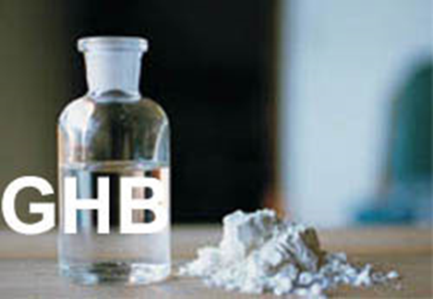
Club & Street Drugs – GHB (gamma hydroxybutrate)
Illegally produced
Liquid has no color or odour
Designer drug made for purpose of getting people high
Swallowed in liquid or powder form, mixed in water, or as tablets
Causes euphoric high-intense rush of happy feelings and hallucinations
Kills more people than ecstasy
Side Effects
vomiting, breathing problems dangerously decreased heart rate, seizures

Slide 30
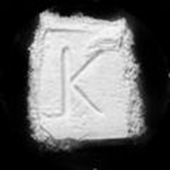
Club & Street Drugs – Ketamine
Fast acting anaesthetic and pain killer
used primarily in veterinary surgery, and human medicine
Produces vivid dreams of hallucinations
Makes user feel that the mind is separated from the body “dissociation”
For medical use - sold in liquid form
white powder is snorted, mixed into drinks, or smoked with marijuana
Liquid added to drinks or injected
Dissolves when slipped into drinks

Slide 31
Club & Street Drugs – Ketamine
Effects felt between 1-10 min after use
Duration about one hour
What happens:
Drunken and dizzy feeling
Numbness of body, Blurred vision, Confusion, feeling of being “weightless”
Intense, terrifying hallucinations
Loss of consciousness
Prevents user from feeling pain
Leads to suffocation – by breathing vomit into lungs
Reduces level of oxygen in the brain, heart and muscles which can lead to death

Slide 32
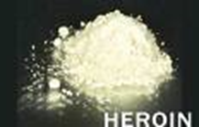
Club & Street Drugs – Heroin
Processed from morphine - from opium poppy
“downer” affects brain’s pleasure systems
interferes with brains ability to feel pain
Colors vary – dark brown sugar, white, tar-like
Strength of drug or true contents unknown
high chance of overdose or death
sharing needles / equipment cause other diseases and problems
leads to flushing of skin, dry mouth, collapsed veins, liver disease
Cut with other drugs or substances
additives don’t dissolve leading to clogs in blood vessels that lead to lungs, liver, kidney or brain
tolerance develops with regular use – user needs more heroin to achieve same intensity

Slide 33
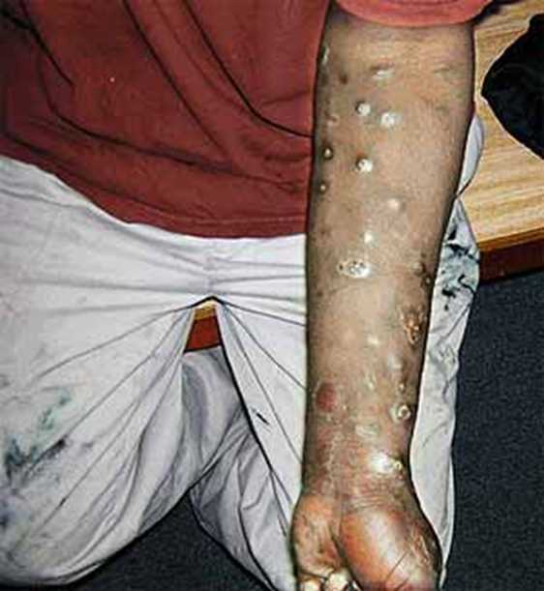

Slide 34
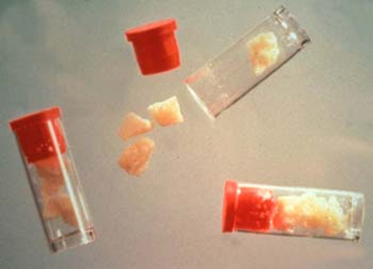
Club & Street Drugs – Crack + Cocaine
Cocaine is a stimulant drug
more alert, energetic, talkative, euphoric
More aware of senses
increases sound, touch, sight and sexuality
Reduces hunger and need to sleep
Increase in self-control and confidence
High doses cause panic attacks, psychotic episodes (paranoia), violent behavior
White powder from the leaves of coca plant
Can be one of the hardest drugs to quit
Cocaine Withdrawal
Agitation and restless behavior , Craving – can last months, Depressed mood – can last months, Fatigue, Generalized malaise , Increased appetite , Slowing of activity, Vivid and unpleasant dreams

Slide 35
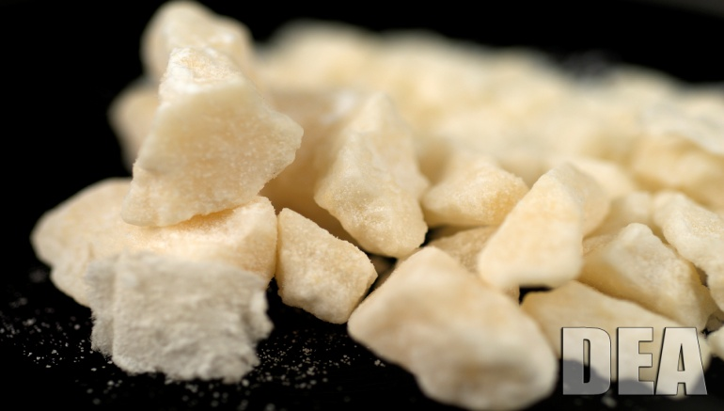
What is…CRACK COCAINE?
Crystal form of cocaine that is heated and smoked.
It is so named because it makes a cracking or popping sound when heated.
The most potent/riskiest form in which cocaine appears.
Smoking crack allows it to reach the brain more quickly and brings an intense and immediate high that last about 15 minutes.
Notes:
**VIDEO

Slide 36
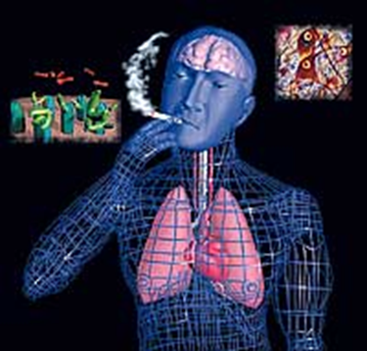
Club & Street Drugs – Crack + Cocaine
Blood vessels thicken and constrict, reduce flow of oxygen to heart
Heart muscles work harder can lead to heart attack or stroke, raises blood pressure, can explode weakened blood vessels in brain
Small amount can lead to overdose
Overdose can cause seizure or heart failure
Snorting cocaine
sinus infection, loss of smell, damage tissue,
hole in nose, damage lungs
Cocaine increases the same chemicals in the brain that make people feel good when they eat, drink or have sex
Dopamine
blocks re-uptake protein and allows DA to remain in synapse
Chronic use - DA receptor down-regulation
Depression - result from decreased DA activity after withdrawal
Sensitization - brain is more sensitive to things that increase DA (cocaine)

Slide 37
Anxiety Disorders and Stimulants
excessive caffeine or stimulant use - mimic symptoms of anxiety, counteract sedation and increase insomnia
increased heart rate, nervousness, flushed face, gastrointestinal disturbances, muscle twitching, palpitations and sweating
may request higher doses of benzodiazepines to mask both underlying symptoms AND stimulant effects

Slide 38
Schizophrenia and Cocaine
reduces negative symptoms & relieves feelings of depression
may feel that it increases ‘focus’ or attention
may cause dystonia and/or dyskinesia
increases agitation and propensity for violence

Slide 39
Club & Street Drugs–Crystal Meth
Man-made drug
Easy to produce (15 chemicals used)
Main ingredient pseudo ephedrine (cold remedy)
Investment of $150 = yield $10,000
Each kg of meth produced 5-7kg of chemical waste dumped down the drain or dumped in backyard
By-product is toxic gas which causes fires or explosions
Used in Second World War to keep pilots awake on long missions
Methamphetamine releases high levels of dopamine in the brain a neurotransmitter that is associated with pleasurable or rewarding experiences
User feels increased wakefulness and physical activity and decreased appetite

Slide 40
Club & Street Drugs – Crystal Meth
Higher doses
Cause irritability, insomnia, confusion, hallucinations, anxiety, paranoia and increased aggression
Even higher doses can cause hypothermia, convulsions and lead to death
When body is stimulated by meth it causes irreversible damage
Increased heart rate and blood pressure damage blood vessels in the brain, causing strokes, irregular heart beat causing a collapse or death

Slide 41
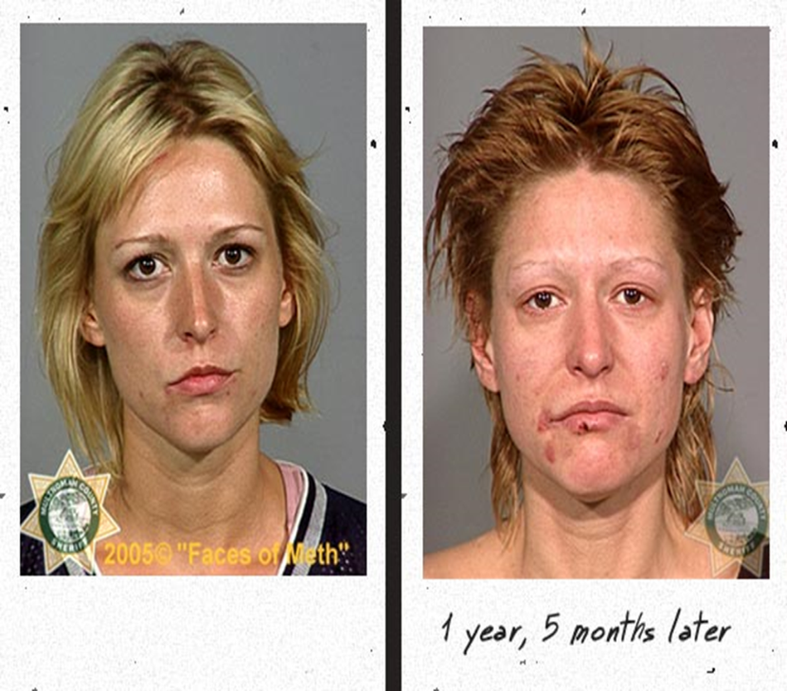
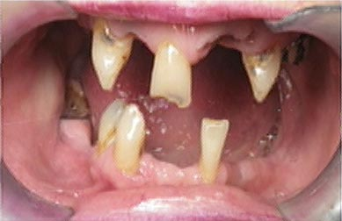
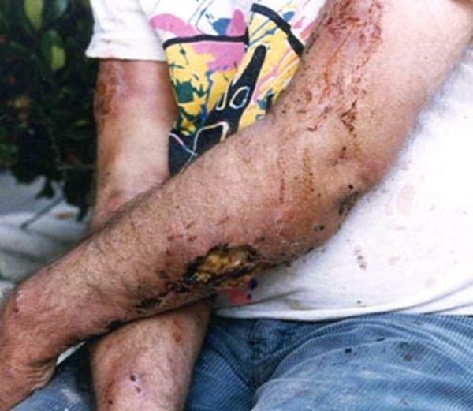

Slide 42
RX Drug Abuse
Definition :
Prescription drug abuse is using prescription medication in a way that isn’t prescribed by a health care practitioner, or using someone else’s prescription
Who is abusing them?
Examples:
Misuse of laxatives, diuretics and diet aids to improve personal appearance
Mixing alcohol + prescription drugs to achieve & enhance “high”
Use of codeine cough syrup to achieve intoxication
Misuse of stimulants to enhance performance

Slide 43
Schizophrenia and antipsychotics Depression and Antidepressants Bipolar disorders and Mood Stabilizers
Pharmacotherapy in Psychiatry

Slide 44
Schizophrenia and antipsychotics
Characterized by psychosis, hallucinations, delusions, cognitive defects, occupational and social dysfunction
Positive and Negative symptoms
Chronic psychotic illness
Episodic exacerbations and remissions with residual symptoms
Complete remission is not common
Onset
late teens or early 20s in males
sometime later in females
Suicide rate comparable to depressive illness
approx 10%
Antipsychotics
Typical / Conventional antipsychotics
Atypical antipsychotics

Slide 45
Schizophrenia and Antipsychotics
No consistent neuropathology or biomarkers for schizophrenia
? Increased dopamine in mesolimbic pathways causes delusions and hallucinations
? Dopamine deficiency in mesocortical and nigrostriatal pathways causes negative symptoms (apathy, withdrawal)
Hallucinogens produce effect through action on 5-HT2 receptors

Slide 46
Antipsychotics
Typical / Conventional Antipsychotics (AKA Dopamine receptor antagonists”, “Neuroleptics” “Major tranquilizers” )
Atypical Antipsychotics
(AKA “Serotonin-dopamine antagonists”)
Chlorpromazine (Largactil®)
Flupenthixol (Fluanxol®)
Haloperidol (Serenace®, Haldol®)
Pericyazine (Neulactil®)
Pimozide (Orap®, Orap Forte®)
Sulpiride (Dogmatil®)
Thioridazine (Melleril®)
Trifluoperazine (Stelazine®)
Thiothixene (Navane®)
Amisulpiride (Solian®)
Quetiapine (Seroquel®)
Ziprasidone (Zeldox®)
Risperidone (Risperdal®)
Olanzapine (Zyprexa®)
Clozapine (Clozaril®)
Aripiprazole (Abilify®)
Paliperidone (Invega)

Slide 47
Typical / Conventional Antipsychotics
Properties
Effective in reducing positive symptoms during acute episodes and in preventing their reoccurrence
Less effective in treating negative symptoms
Some concern that they may exacerbate negative symptoms by causing akinesia
Higher incidence of EPS / sedation / anticholinergic Adverse effects
Differ from one another in terms of potency - i.e. size of dose to achieve a given response
Low potency - Chlorpromazine, thioridazine
Medium potency - Perphenazine
High potency - Trifluoperazine, thiothixene, fluphenazine, haloperidol, pimozide

Slide 48
Typical Antipsychotics: Adverse effects
Extrapyramidal symptoms (EPS)
Early reactions
Acute dystonia
Parkinsonism
Akathisia
Late reaction
Tardive dyskinesia (TD)
Neuroleptic malignant syndrome (NMS)
Other Adverse effects
Prolactinemia
Sedation
Seizures

Slide 49
Atypical Antipsychotics
Mechanism of action
Similar blocking effect on D2 receptors
At least as effective as typicals for positive symptoms
May be more efficacious for negative and cognitive symptoms (still under debate)
Properties
Less frequently associated with EPS
More risk of weight gain, new onset diabetes, hyperlipidemia
Novel agents, more expensive

Slide 50
Atypical antipsychotics
Potency
All equally effective at therapeutic doses
Except clozapine
Most effective antipsychotic
For resistant schizophrenia
2nd line due to life-threatening side effect
Rare cases of myocarditis and cardiomyopathy
Fatal
Most commonly in first 2 months
Caution
Seizure disorders
Diabetes

Slide 51
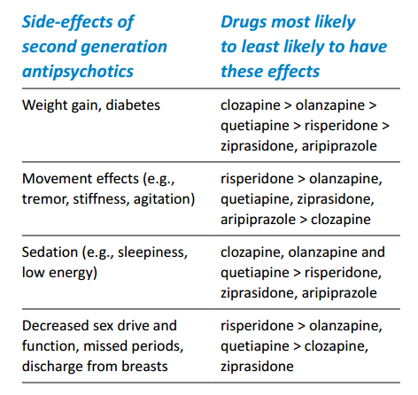

Slide 52
Atypical Antipsychotics
Comparison of representative atypical antipsychotics
Drug | Advantages | Disadvantages
Clozapine | For treatment-resistant cases, little EPS | Risk of fatal agranulocytosis
Risperidone | Broad efficacy, little or no EPS at low doses | EPS and hypotension at high doses
Olanzapine | Effective with positive and negative symptoms, little or no EPS | Weight gain
Quetiapine | Similar to risperidone, maybe less weight gain | Dose adjustment with associated hypotension, bid dosing
Ziprasidone | Perhaps less weight gain than clozapine, Inj A/V | QT prolongation
Aripiprazole | Less weight gain, novel mechanism potential | Uncertain

Slide 53
Antipsychotics in Schizophrenia
Oral administration
Divided daily doses at initial phase THEN Once daily at bedtime when stabilized
Promoting sleep and reducing daytime sedation
Smallest effective dose employed
Oral-dispersible and solution preparations
For unreliable patients
Injections
Usually deltoid or gluteal muscle (or according to manufacturer)
Depot injections
At intervals of 1 to 4 weeks
Generally not more than 2-3ml oily injection at one site
Correct injection technique (z-track) and injection site rotation

Slide 54
Antipsychotics in Schizophrenia
Treatment response
First 7 days
Decreased agitation, hostility, combativeness, anxiety, tension and aggression
Normalization of sleep and eating habits
First 2-3 weeks
Increased socialization, improvement in self-care
6-8 weeks
Improvement in formal thought disorder
Phases
Acute phase
Stabilization phase
Maintenance phase

Slide 55
Antipsychotics – Finally
Non-antipsychotic agents
Benzodiazepines
Lithium
Valproate
Propranolol
Antidepressants and mood stabilisers
Differentiate between adverse effects and signs of disease progression

Slide 56
Depression and Antidepressants
DSM-V
Epidemiology
Life prevalence 3-17%
Onset in late 20s
Highest in
25-44 years
Elderly in community
Female vs male = 2:1
Female 10-25% lifetime risk VS Male 5-12% lifetime risk
Signs and symptoms
Depressed mood and/or decrease in interest in things that used to give pleasure
Sadness severe enough or persistent enough to interfere with function

Slide 57
Antidepressants
Tricyclic and related antidepressants (TCA)
E.g. amitriptyline, imipramine, doxepin, mianserin, trazodone
Monoamine-oxidase inhibitors (MAOI)
E.g. moclobemide, phenelzine, isocarboxazid, tranylcypromine
Selective serotonin reuptake inhibitors (SSRI)
E.g. fluoxetine, paroxetine, sertraline, citalopram
Other antidepressants
E.g. mirtazapine, venlafaxine, duloxetine, flupentixol

Slide 58
Tricyclic & related Antidepressants (TCA)
Mechanism of action
Initial response develops in 1-3 weeks
Maximal response develops in 1-2 months
Older tricyclics
Marked anticholinergic Adverse effects
Risk of cardiotoxicity
Tricyclic-related drugs (e.g. trazodone)
Fewer anticholinergic Adverse effects
Sedation, dizziness, priapism (persistent penile erection acompanied by pain and tenderness)
Very dangerous in overdose
Life threatening
Lethal dose only 8 times average daily dose
Acutely depressed patients should not be given more than 1-week TCA supply at one time

Slide 59
Tricyclic and related antidepressants (TCA)
Adverse effects
Drug interactions
Orthostatic hypotension
Anticholinergic effects
Sedation
Cardiac toxicity
Seizures
Hypomania (mild mania)
Elevated mood
Diaphoresis
CNS depressants
Narcotics, benzodiazepines
Additive CNS depression
Anticholinergics
Additive anticholinergic effects
P450 enzyme inducers/inhibitors

Slide 60
Monoamine-oxidase inhibitors (MAOI)
Moclobemide (Aurorix®), Phenelzine, Isocarboxazid , Tranylcypromine
Inhibit both /or MAO-A and MAO-B
Uses
atypical depression, refractory disorders and certain types of anxiety disorders
Cautions
Danger of dietary and drug interactions
Hypertensive crisis
Orthostatic hypotension
Insomnia
Weight gain
Sexual dysfunction

Slide 61
Selective serotonin reuptake inhibitors (SSRI)
Fluoxetine (Prozac®)
Fluvoxamine (Faverin®)
Paroxetine (Seroxat®)
Sertraline (Zoloft®)
Citalopram (Cipram®)
Escitalopram (Lexapro®)
Mechanism of action
Inhibits reuptake of serotonin (5-HT) presynaptic uptake
Increases availability of serotonin at synapses

Slide 62
Selective serotonin reuptake inhibitors (SSRI)
Properties
Some also indicated for
Overdose less likely to be fatal
Less anticholinergic side effects
But more GI side effects
Seems to be better tolerated
Fluoxetine
Most stimulating SSRI
Indicated for premenstrual dysphoric disorder (PMDD)
Long half-life
Obsessive-compulsive disorder (OCD)
Panic disorder
Eating disorders
Social phobia
Post traumatic stress disorder (PTSD)

Slide 63
Selective serotonin reuptake inhibitors (SSRI)
Adverse effects
Serotonergic syndrome
Headache
GI
Anticholinergic Adverse effects
Tend to see more with paroxetine
Somnolence or insomnia
Increase in anxiety, agitation, early in treatment (
fluoxetine
Agitation or nervousness
Sexual dysfunction
Rare but potentially fatal interaction between 2 or more drugs that enhance serotonin

Slide 64
Serotonin norepinephrine reuptake inhibitor (SNRI)
Duloxetine (Cymbalta®), Venlafaxine (Efexor®, Efexor XR®)
Mechanism of action
Inhibits norepinephrine and serotonin reuptake
Potentiates neurotransmitter activity in the CNS
Duloxetine also indicated for diabetic neuropathy

Slide 65
Norepinephrine Dopamine reuptake inhibitor (NDRI)
Bupropion (Wellbutrin SR®)
Mechanism of action
Inhibits weakly the neuronal uptake of dopamine, norepinephrine and serotonin
Does not inhibit monoamine oxidase
GI side effects, confusion, dizziness, headache, insomnia, tremor
Seizure risk at high doses
Minimal risk of sexual dysfunction
Also licensed for smoking cessation (Zyban®)

Slide 66
Other antidepressants
Flupenthixol (Fluanxol®)
Typical antipsychotic
Antidepressant effect at low doses
Anxiolytics
Antipsychotics
Use may mask the true diagnosis
Used with caution
But are still useful adjuncts in agitated patients
Lithium and thyroid
To potentiate effect of antidepressants in refractory cases

Slide 67
Choice of Antidepressants
All are equally efficacious for depression
Selection based on
Side effect profile
Potential drug interaction
Response failure to an antidepressant does not predict response to another drug class or another drug within class
Geriatrics
Pediatrics

Slide 68
Treatment response
Weeks 1-2
Physical responses
Improvement in appetite and sleep
Weeks 3-4
Energy and cognitive responses
Improvement in energy
Improvement in guilt, concentration
Weeks 5-6
Emotional responses
Improvement in mood

Slide 69
Antidepressants in depression
Continuation therapy
To prevent relapse
4-9 months after complete remission of symptoms
At therapeutic doses
Lifelong maintenance therapy
Recommended by some for patients at greater risk or reoccurrence
< 40 years with ≥ 2 prior episodes
Any age with ≥ 3 prior episodes

Slide 70
Bipolar Disorders and Mood Stabilizers
Cyclic disorder with recurrent fluctuations in mood, energy and behaviour, “mood swings”
Episodes of mania and/or hypomania, and major depression that cause marked impairment and/or hospitalization
Devastating long term illness
Deterioration in functioning
Suicidal ideation
Substance abuse
Noncompliance to meds

Slide 71
Bipolar Disorders and Mood Stabilizers
Prevelance 1-2%
Male = female
Average age of onset 20 to 30
10-15% rate of suicide
Exact case unknown
Neurotransmitters known to be involved
Serotonin
Norepinephrine
Dopamine

Slide 72
Bipolar disorders : Signs and symptoms
Hypomania
Distinct period of persistently elevated, expansive, or irritable mood
Lasting throughout at least 4 days
< 1 week for mania
Different from usual non-depressed mood
But not severe enough to cause marked impairment in social or occupational functioning
Mania
Distractability
Insomnia
Grandiosity or inflated self-esteem
Flight of ideas or subjective experience that thoughts are racing
Agitation or increase in goal-directed activity
Speech pressured/more talkative than usual
Taking risks

Slide 73
Bipolar Disorders: Signs and Symptoms
Mixed episode
Simultaneous occurrence of manic and depressive symptoms nearly every day for at least 1 week
Poorer prognosis
More seen in younger and older patients
Less likely to respond to mood stabilizer monotherapy
Rapid cyclers
> 4 major depressive or manic episodes (manic, mixed or hypomanic for 12 months)
Frequent and severe episodes of depression
Poorer prognosis
Often require combination therapies

Slide 74
Mood stabilizers
Lithium
Anticonvulsants
Valproate
Carbamazepine
Lamotrigine
Antipsychotics, antidepressants and others

Slide 75
Lithium
Manic episode
Approved for manic episodes and maintenance therapy
About 70% patients show at least partial reduction of mania
Full effect takes 1-2 weeks
Depressive episode
As adjunct to antidepressant for refractory patients
Onset 4-6 weeks
Long term use reduces suicide risk and mortality
Narrow therapeutic index
Start with low divided doses
Numerous drug interactions!
Dietary sodium, soda, coffee, tea, caffeine INCREASE lithium clearance
Acute mania increases lithium clearance

Slide 76
Lithium
Adverse effects
Early, dose related Adverse effects
GI distress
Sedation, weight gain
Muscle weakness
Polyuria, polydipsia
Impaired cognitive funciton
Tremor
Tolerance may develop
Management
Take with meal
Beta blocker for tremor
Late Adverse effects
Psoriasis / acne exacerbation
Nephrogenic diabetes insipidus
Hypothyroidism
Cardiac
T-wave flattening or inversion
Bradycardia
AV block
Leukocytosis
Lithium toxicity (serum level > 1.5-2.5 mmol/L)

Slide 77
Anticonvulsants
Carbamazepine (Tegretol®, Tegretol CR®)
Lamotrigine (Lamictal®)
Valproate (Epilim EC®, Epilim Chrono®)
Approved for acute mania and mixed episodes in bipolar I disorder

Slide 78
Adverse effects
Carbamazepine
Weight gain
Neurotoxicity
Mild elevation of liver enzymes
Hypersensitivity rash
Lamotrigine
Skin rash
GI
Asthenia, pain
Ataxia, dizziness, headache, somnolence
Valproate
GI
Irreversible but rare hepatotoxicity
Weight gain, increased appetite
Sedation, tremor
Menstrual disturbances and polycystic ovaries is possible
Transient alopecia

Slide 79
Other anticonvulsants AND Other Drugs
Oxcarbazepine (Trileptal®)
Topiramate (Topamax®)
Antipsychotics
Antidepressants
Benzodiazepines

Slide 80
Understanding basic medication-related issues in clients with common psychiatric conditions:
A primer for individuals working
within the justice system
with specific focus on:
street drugs
antipsychotic medications
antidepressants
mood stabilizers

