Slide 1
Harm Reduction on “The Inside”
P A S A N Lindsay Jennings
HSJCC
January 4, 2018

Slide 2
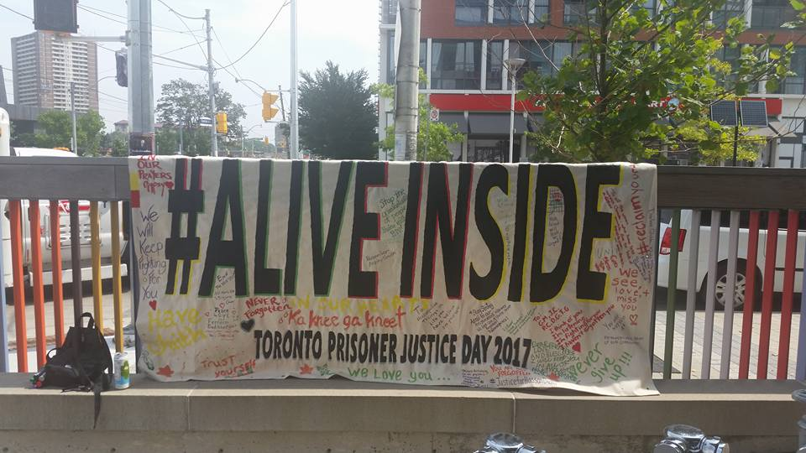
P A S A N
PASAN(Prisoners with HIV/AIDS Support Action Network) is a community-based organization in Ontario that provides support, education and advocacy services related to HIV/HCV and harm reduction with the prisoner and ex-prisoner populations and within the prison environments.

Slide 3
P A S A N
PASAN is the only organization in Canada that exclusively works with prisoners and ex-prisoners around HIV/HCV and harm reduction.
We strive to ensure that prisoners living with HIV/HCV are receiving the healthcare and support that they deserve and are entitled to; as well, to facilitate continuity of care when people are returning back into the outside community.

Slide 4
OUR GOAL
We aim to engage corrections to exchange information and to have an impact on correctional policies and practices that have a negative impact by upholding stigma and discrimination for prisoners living with HIV/HCV, or being a prisoner inside a jail
We carry out capacity building training and workshops in the community for agencies that work with people who are in and out of prison.

Slide 5
On the “Inside”
Through education sessions inside prison, we provide opportunities for prisoners to learn about and discuss topics such as;
HIV/HCV-transmission and prevention, testing and treatment
Sexual health- general health
Harm Reduction- safer drug use/sex/tattooing/selfharming
Overdose Prevention
Reintegration Plans- informal unless its healthcare related
Informally discuss trends or situations that are happening inside the jail, and how it is affecting prisoners
Notes:
Workshops inside: in order to equip people with updated and accurate information about high risk activities,

Slide 6
HIV/HCV & IN prison
Many of the dynamic factors that lead to poor health—processes of marginalization, illicit substance use, poverty, early childhood trauma, homelessness—are associated with increased likelihood of incarceration and higher risk of contracting HIV or HCV.
Prisoners may not have access to basic tools to manage their health care
Stigma, overcrowding, limited access to health care, and the stress of incarceration contribute to the vulnerable health status of prisoners and ex-prisoners
Healthcare or maintenance of their HIV status looks different when incarcerated
Provincial Prisoners are not eligible for HCV treatment

Slide 7
War on Drugs
Legislation of marijuana- how is this going to affect our justice systems
Criminalization of drug users
Manslaughter charges for fentanyl trafficking charges
Mental health and drug use…which came first?

Slide 8
One Day at a Time
Non conducive to rehabilitation
12-14 hrs min lockup, otherwise locked out
Yard, lockdown, programs, school, visits, hygiene
General population vs. protective custody
Pat downs, cell searches, strip searches, random urinalysis
Segregation
“Crime school”
Double-bunking-against U.N. standards

Slide 9
Subculture and Unwritten Rules
Confidentiality
Currency (sex, meds, 3-way calls, food, canteen,etc.)
Doing your own time
Violence, “Muscling”
The notion of being “solid”
Racking up debts (drugs, tobacco, etc.)
Pecking order

Slide 10
Effects of Institutionalization
Sense of space
Pace of life
Squeaky wheel gets the grease
Authority figures
Lack of socialization, input, control
Grooming
Hoarding
Language
Post-Incarceration Syndrome (PICS)

Slide 11
Transitioning back into the Community
ID replacement, housing, employment, clothing, transportation, ODSP, $$$
Healthcare appointments
Overdose risks
Factors for recidivism
Stigma
Released from court, property
Support around addictions
Support around trauma

Slide 12
Relationships Challenges
The relationship between prisoners and healthcare providers is generally not positive.
There is often mistrust due to poor treatment and/or previous negative experiences, including being labelled as drug-seeking, manipulative and/or criminals.
When out of prison, some people have significant challenges around getting to and keeping appointments due to poverty, cognitive challenges and geographical location (i.e. rural, remote, underserved areas).
The prison environment socializes people to tell authority figures what they think they want to hear in order to get their needs met.

Slide 13
Important Things to Consider
The role of trauma, both in early life and throughout life, and how that impacts self-esteem, behaviour, decision-making and judgement.
The ways that prison subculture, range survival and institutionalization impact behaviour.
The stigmatization and general feeling of powerlessness people feel inside and post-release from prison.
The complexity of sexual orientation identity in prison and post-release from prison.

Slide 14
Things That Are Non-Conducive to Building Trust
Asking an ex-prisoner what they did time for
Breaching confidentiality
Asking about another prisoner
Making promises you can’t keep
Rationalizing punishment
Accepting prison staff reports about a person’s behaviour without listening to the person’s perspective in privacy
Speaking down to a person
Imposing your views or moral standards

Slide 15
Some Quick Tips - 1
CHALLENGE:
People seem like they are over-emphasizing one aspect of their health or seem like they are not being forthcoming with information.
SUGGESTION:
As part of being institutionalized, prisoners learn to prioritize one thing and highlight it as a way to get their needs met. Understand the series of events that have occurred in a person’s life by allowing time for a person to give a brief biographical narrative and pay specific attention to traumatic areas of their narrative.

Slide 16
Some Quick Tips - 2
CHALLENGE:
People often present as non-communicative and non-cooperative while interacting with you.
SUGGESTION:
Be sensitive to the reality that the person may have a heightened sense of anxiety and mistrust due to their past experiences. Understand the possibility of fear of being judged and fear of being criminalized. Always use a non-judgemental approach, outline confidentiality and emphasize that the more you know, the more you can help the person.

Slide 17
Some Quick Tips - 3
CHALLENGE:
People aren’t consistent with showing up for appointments/court dates.
SUGGESTION:
Make sure that you take the time to explain procedures, diagnoses, treatments and results and ensure the person understands the information and their options.

Slide 18
Some Final Things to Consider - 1
Prisoners and ex-prisoners often normalize not feeling okay and minimize symptoms that they are experiencing.
When people are ready or desperate to address their health issues, they need an anchor because they may have no idea where to start, what to tell or what to ask.
When people are released from prison, they usually do not have identification because it has either been lost in the prison or confiscated/destroyed by police during arrest or they were released from court without their personal belongings.

Slide 19
Some Final Things to Consider - 2
The waiting room/courthouse/intake rooms can be a place of high anxiety due to being in close proximity to people, feeling judged or paranoid, nervousness about the interaction with the worker or simply the act of waiting can be stressful.
Healthcare environments or any place that can feel institutional can resemble the prison environment in overt or nuanced ways. When people are spoken down to or belittled, this can trigger past experiences with prison guards.

Slide 20
Contact PASAN
www.pasan.org
416-920-9567 or 1-866-224-9978
lindsay@pasan.org

