Slide 1
P-HSJCC Webinar Series: History of Childhood Abuse in Populations Incarcerated in Canada
April 15, 2019
Moderator: Tasha Rennie
About today’s webinar:
We will have a Q&A period at the end of our webinar. To ask a question, please type your question in the chat box.
This webinar will be recorded. The recording and power-point presentation will be emailed to you following the webinar.
Please complete the brief evaluation survey following the webinar.
About the HSJCC Network:
The Human Services and Justice Coordinating Committee (HSJCC) Network is comprised of: 39 Local Committees, 14 Regional Committees, and one Provincial HSJCC
Each HSJCC is a voluntary collaboration between health and social service organizations, community mental health and addictions organizations and partners from the justice sector including crown attorneys, judges, police services and correctional service providers.

Slide 2
Prevalence of Exposure to Childhood Abuse Amongst People in Prison in Canada: A Systematic Review and Meta Analysis
Claire Bodkin and Fiona Kouyoumdjian
Department of Family Medicine, McMaster University
April 15, 2019

Slide 3
Who we are
Claire Bodkin is a final-year medical student who is starting her residency training in Family Medicine in July. She has trained in a variety of settings, including correctional facilities, and strives to act in solidarity with people who experience imprisonment.
Fiona Kouyoumdjian is a Family Physician and works part-time at a provincial correctional facility and does research on the health status of people who experience imprisonment.

Slide 4
Other project team members
Lucie Pivnick and Carolyn Ziegler at St. Michael’s Hospital
Sue Bondy at the Dalla Lana School of Public Health at the University of Toronto
Ruth Elwood Martin at the University of British Columbia
Carey Jernigan at Columbia University

Slide 5
Conflicts of interest
none

Slide 6
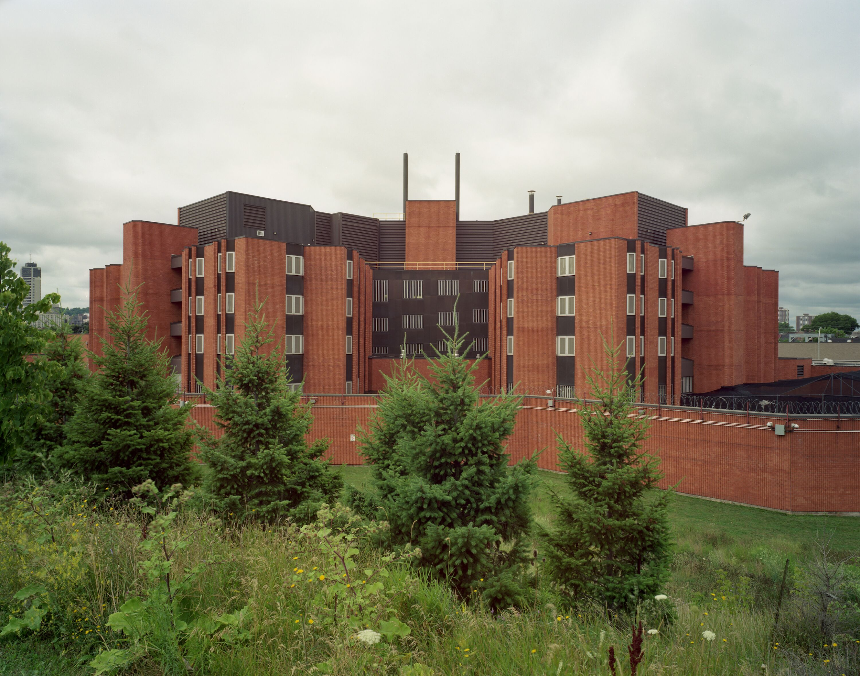
Background
~50,000 people are detained or incarcerated in provincial prisons in Ontario each year.
People in prison have often experienced abuse and other traumatic experiences in childhood.

Slide 7
Childhood abuse and imprisonment
Could be associated through different mechanisms:
child abuse → perpetration of violence
child abuse → substance use disorders → imprisonment
poor parenting/family disorganization → child abuse → imprisonment
If trauma is common in this population, we need to consider how this affects the care and services that we provide for people in the criminal justice system.

Slide 8
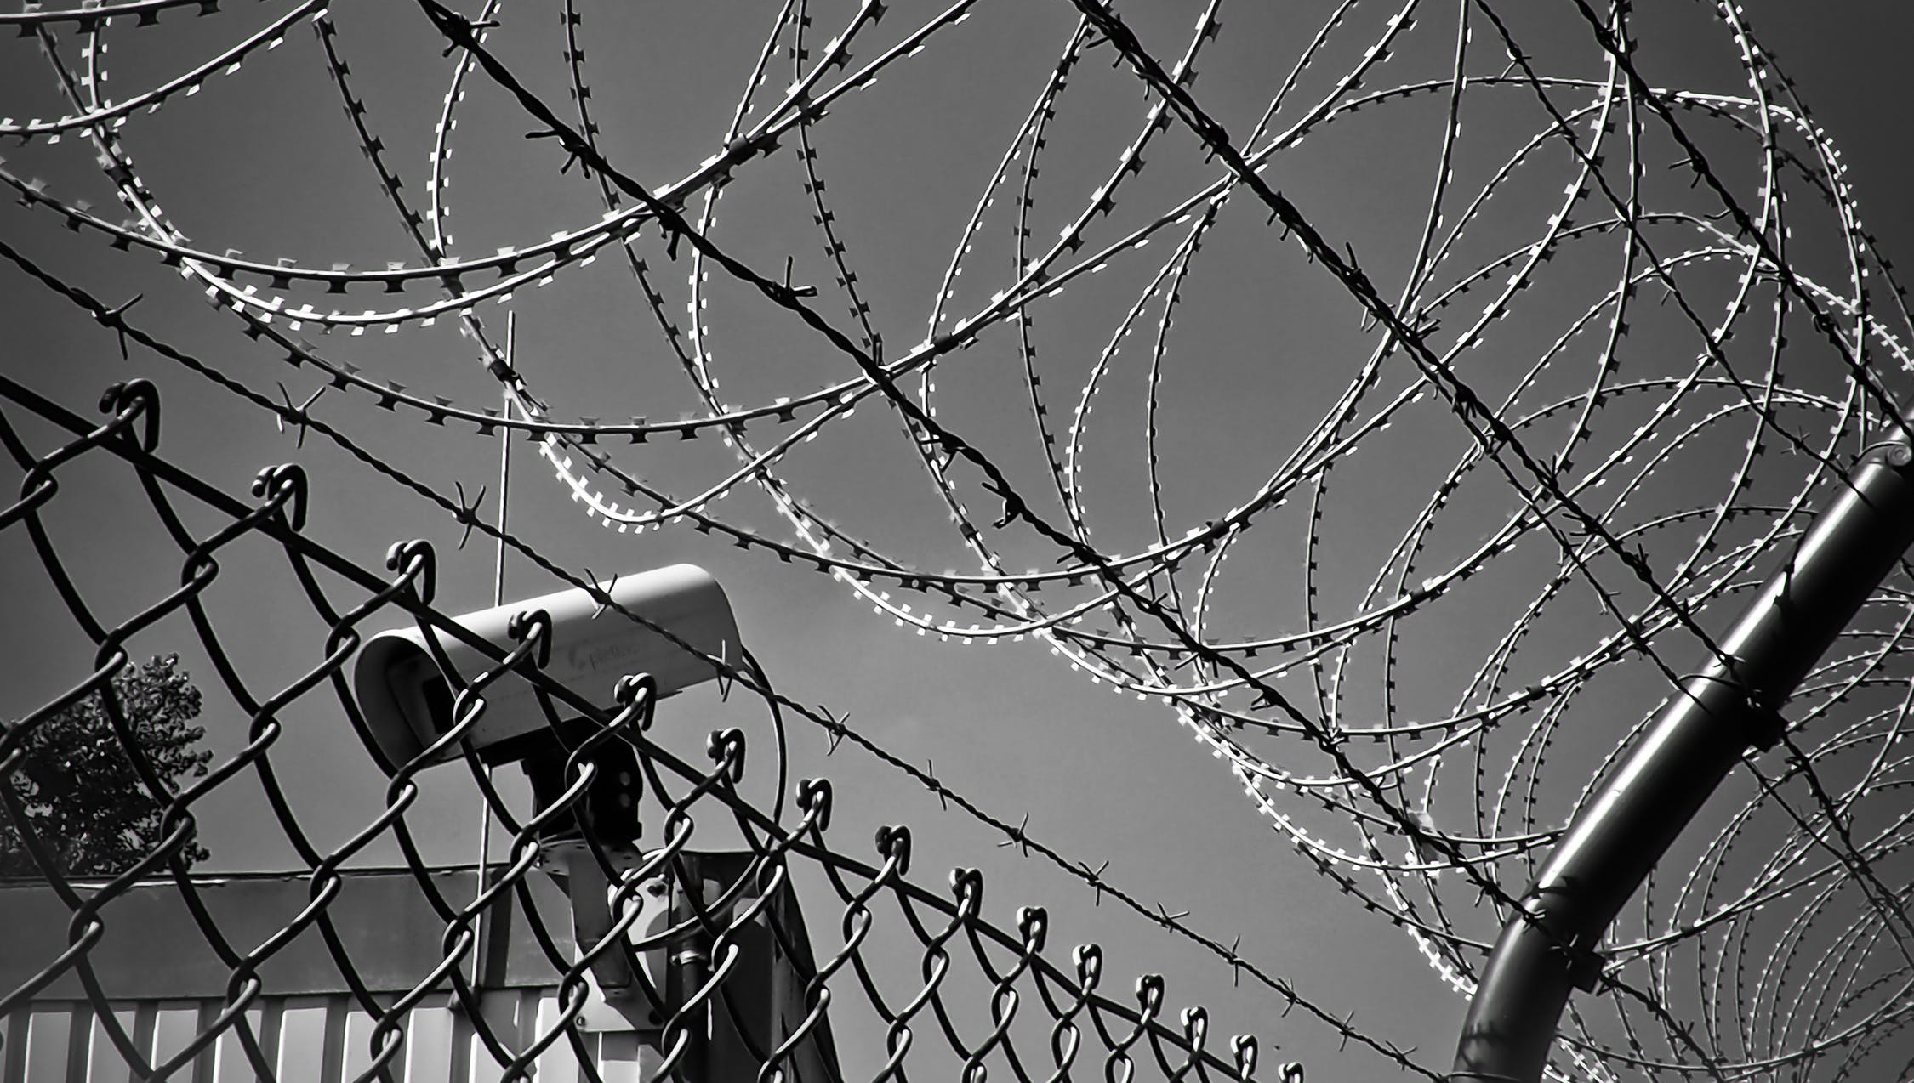
Study objective
To summarize data on the prevalence of a history of child abuse in people in prisons in Canada.
Notes:
Image source https://www.pexels.com/photo/abstract-barbed-wire-black-white-black-and-white-274886/

Slide 9
Methods
Systematic review and meta-analysis steps
search for all studies and reports on the topic
structured process to review all identified articles and select those that meet inclusion and exclusion criteria
extract relevant data and assess risk of bias
summarize data on all included studies
meta-analysis involves using statistical methods to summarize results across studies

Slide 10
Our study methods
search: 12 databases, reference lists, grey literature for studies from 1987 to 2017, expert consultation
inclusion criteria:
people in prison in Canada
child abuse at <18 yo (based on WHO definition)
quantitative studies reporting prevalence
review: 2 project team members independently reviewed all titles/abstracts, and all full texts
analysis:
qualitative summary of study characteristics
meta-analysis to generate pooled estimates for each type of child abuse, by sex if appropriate

Slide 11
Child abuse definition
World Health Organization:
Child abuse or maltreatment constitutes all forms of physical and/or emotional ill-treatment, sexual abuse, neglect or negligent treatment or commercial or other exploitation [of children under 18 years of age], resulting in actual or potential harm to the child’s health, survival, development or dignity in the context of a relationship of responsibility, trust or power.
Notes:
http://www.who.int/mediacentre/factsheets/fs150/en/
Photo https://www.pexels.com/photo/abstract-barbed-wire-black-white-black-and-white-274886/

Slide 12
Results
Search identified 1,429 records and we included 34 studies:
Type of abuse | Number of studies
Any child abuse | 7
Child physical abuse | 23
Child sexual abuse | 26
Child emotional abuse | 12
Child neglect | 8

Slide 13
Results
Studies used different methods to collect data:
interview- 17
administrative file review- 17
questionnaire- 8
Notes:
Picture https://www.pexels.com/photo/woman-writing-on-dry-erase-board-1181398/

Slide 14
Results of meta-analysis
*for any child abuse in men, there was a single study with prevalence of 35.5%
Type of abuse | Men | Women
Any | no pooled estimate* | 65.7% (52.6-77.7)
Physical abuse | 47.7% (41.3-54.0)
Sexual abuse | 21.9% (15.7-28.8) | 50.4% (33.5-67.2)
Emotional abuse | 51.5% (34.8-67.9)
Neglect | 42.0% (12.7-74.6) | 51.5% (43.1-59.7)

Slide 15
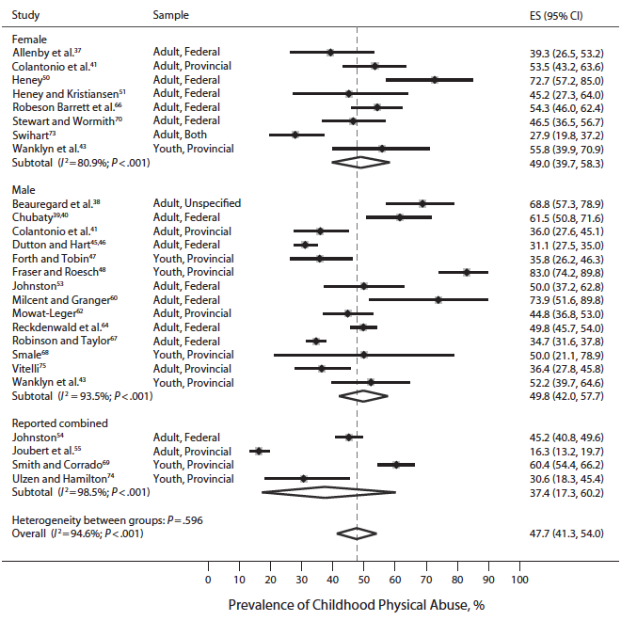
Childhood physical abuse
note that estimates vary substantially, e.g. from 16.3% in Joubert et al. to 83.0% in Fraser and Roesch
note that the summary estimates for women and men are similar

Slide 16
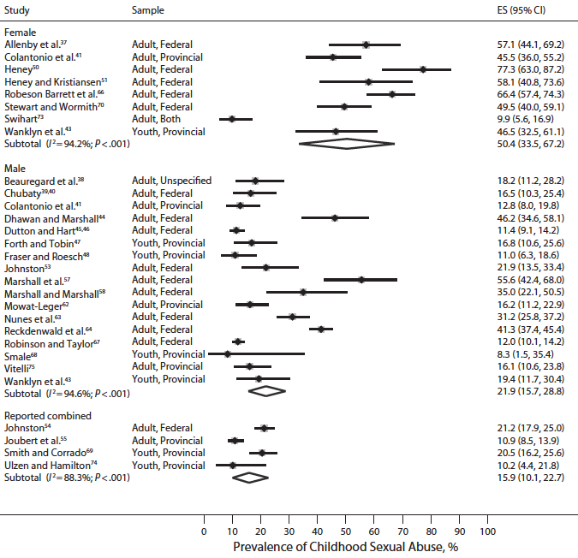
Childhood sexual abuse
note that the summary estimates for women and men are different

Slide 17
Limitations
High risk of bias in most studies in selection and outcome measurement
Heterogeneous estimates
may reflect true differences in prevalence of abuse across populations or differences due to how studies defined or measured abuse

Slide 18
Implications for Research
Relationships
Programs
Policies
Prevention
Harm Reduction
Notes:
What is the relationship between childhood abuse and criminal justice system involvement? What factors prevent involvement? What factors promote it? Is there a difference between who is incarcerated and who is involved in the criminal justice system but not incarcerated?
What programs and care interventions work to prevent criminal justice system (re)involvement? Incarceration? Re-incarceration?
What policies exacerbate or reduce the likelihood that someone with a history of childhood abuse is incarcerated? E.g. bail policies, criminalization of substance use, criminalization of sex work, Gladue report, Indigenous control of child welfare services, funding of on-reserve schools
How do we prevent childhood abuse? E.g. role of child welfare, role of adequate funding of Indigenous services for children
How do we reduce the harms associated with childhood abuse? E.g. role of evidence based substance use disorder treatment

Slide 19
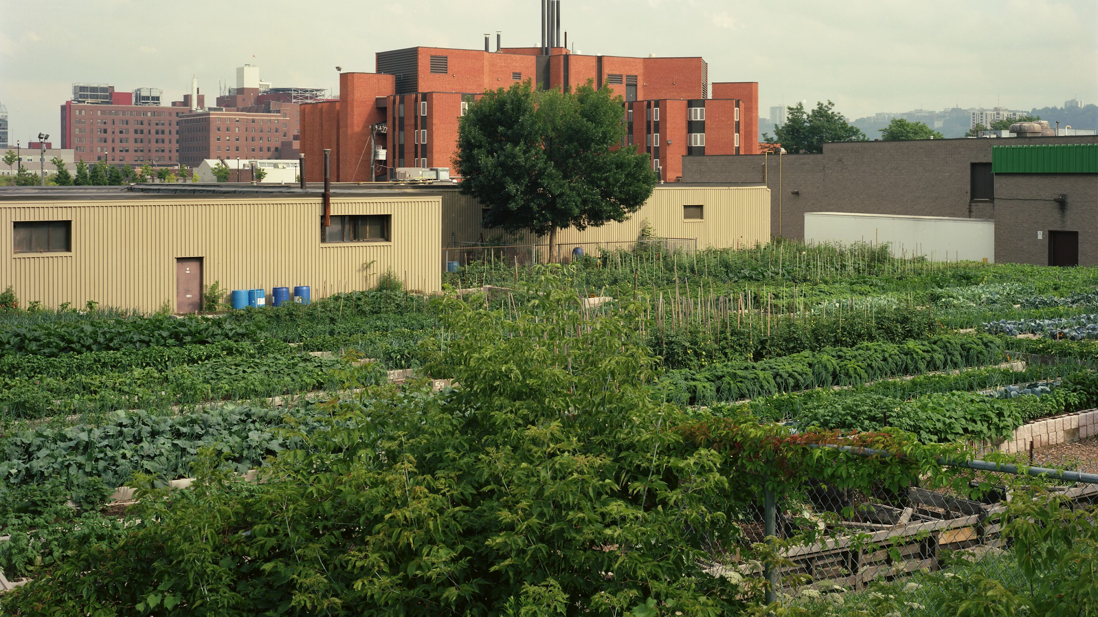
Implications for Practice
Child abuse is associated with mental illness
Prison can exacerbate trauma-related mental illness
Isolation
Lack of control
Re-traumatization
Child abuse & incarceration interact with other structural determinants of health
Notes:
“All types of child abuse were associated with all mental conditions, including suicidal ideation and suicide attempts, after adjustment for sociodemographic variables (adjusted odds ratios ranged from 1.4 to 7.9). We found a dose–response relation, with increasing number of abuse types experienced corresponding with greater odds of mental conditions. Associations between child abuse and attention deficit disorder, suicidal ideation and suicide attempts showed stronger effects for women than men.”¹
Afifi TO, MacMillan HL, Boyle M, Taillieu T, Cheung K, Sareen J. Child abuse and mental disorders in Canada. Canadian Medical Association Journal. 2014 Jan 1:cmaj-131792.
“Prisons are challenging settings for trauma-informed care. Prisons are designed to house perpetrators, not victims. Inmates arrive shackled and are crammed into overcrowded housing units; lights are on all night, loud speakers blare without warning and privacy is severely limited. Security staff is focused on maintaining order and must assume each inmate is potentially violent. The correctional environment is full of unavoidable triggers, such as pat downs and strip searches, frequent discipline from authority figures, and restricted movement.”
Miller NA, Najavits LM. Creating trauma-informed correctional care: A balance of goals and environment. European journal of psychotraumatology. 2012 Dec 1;3(1):17246.
“Familial residential school attendance is shown to affect directly all five health and mental health outcomes, and is associated with lower self-perceived health and mental health, and a higher risk for distress and suicidal behaviours. The association between familial attendance of residential schools and having attempted suicide in the past 12 months remains positively and statistically significantly related in all model outputs. When all covariates are introduced and controlled for, the odds of having attempted suicide are twice the odds of those with no familial attendance of residential schools.”
Hackett C, Feeny D, Tompa E. Canada's residential school system: measuring the intergenerational impact of familial attendance on health and mental health outcomes. J Epidemiol Community Health. 2016 May 11:jech-2016.

Slide 20
What are structural determinants of health?
Notes:
Structural determinants include “all social and political mechanisms that generate … stratification and social class divisions in society and that define individual socioeconomic position within hierarchies of power, prestige and access to resources”
Structural determinants shape proximal determinants of health which in turn affect health outcomes (e.g. racism>over-incarceration>increased risk of death by OD)
Solar O, Irwin A. A conceptual framework for action on the social determinants of health. Social Determinants of Health Discussion Paper 2 (Policy and Practice). 2010.
Photo: Photo by Jimmy Chan from Pexels

Slide 21
What is trauma?
Notes:
Subjective individual experience
Culturally bound
Includes but not limited to childhood abuse
“Exposure to actual or threatened death, serious injury, or sexual violence in one (or more) of the following ways: directly experiencing the traumatic event(s); witnessing, in person, the traumatic event(s) as it occurred to others; learning that the traumatic event(s) occurred to a close family member or close friend (in case of actual or threatened death of a family member or friend, the event(s) must have been violent or accidental); or experiencing repeated or extreme exposure to aversive details of the traumatic event(s) (5th ed.; DSM–5; American Psychiatric Association, 2013, p. 271).”
Photo: Photo by Jimmy Chan from Pexels

Slide 22
What is trauma informed care?
Notes:
Maxine Harris and Roger Fallot are credited with first coining the term.
Trauma informed care begins the moment a person makes contact with an organization providing care, and requires a systems level culture shift and approach.
Trauma informed care: all care/services are aware that they are serving a population with a high(er) prevalence of trauma histories, and services are designed and delivered accordingly (e.g. any healthcare or social service could use a trauma informed care approach).
Vs trauma specific services: services that specifically address and seek to mitigate the effects of trauma directly (e.g. trauma-focused counselling).
Harris M, Fallot RD. Envisioning a trauma‐informed service system: a vital paradigm shift. New directions for mental health services. 2001 Mar 1;2001(89):3-22.
Pillars (some variation between orgs/scholars; this list is from Canadian Centre on Substance Abuse):
Trauma awareness
Safety & trustworthiness
Opportunity for choice, collaboration and connection
Strengths-based and skill building
Photo: Photo by rawpixel.com from Pexels

Slide 23
Can prisons be(come) trauma informed?
Notes:
Many aspects of prison are at odds with a trauma informed care approach.
That being said, there are still lots of things that can be done:
Screening
Addressing overcrowding/noise/constant lighting other environmental factors
Improved mental health care, including evidence based care for substance use disorders, therapeutic recreation, and cognitive behavioural interventions
Keeping people in prison connected to their outside supports
Increase predictability in schedule and routine
Offering choice
Ensuring a smooth transition on release
Training staff
And much more
Miller NA, Najavits LM. Creating trauma-informed correctional care: A balance of goals and environment. European journal of psychotraumatology. 2012 Dec 1;3(1):17246.
We cannot avoid the realities of incarcerating people and who we incarcerate. We need to consider how prison itself is harmful to people who have histories of childhood abuse, how it exacerbates other structural determinants of health like colonization and racism and wealth inequality.
We need to use every other strategy to care for people besides incarceration: preventing child abuse, preventing criminal justice system involvement, addressing structural determinants of health, stopping the over-incarceration of oppressed groups of people, pursuing alternatives to incarceration, and post-release interventions breaking the cycle of incarceration and re-incarceration that many people with childhood abuse histories experience.

Slide 24
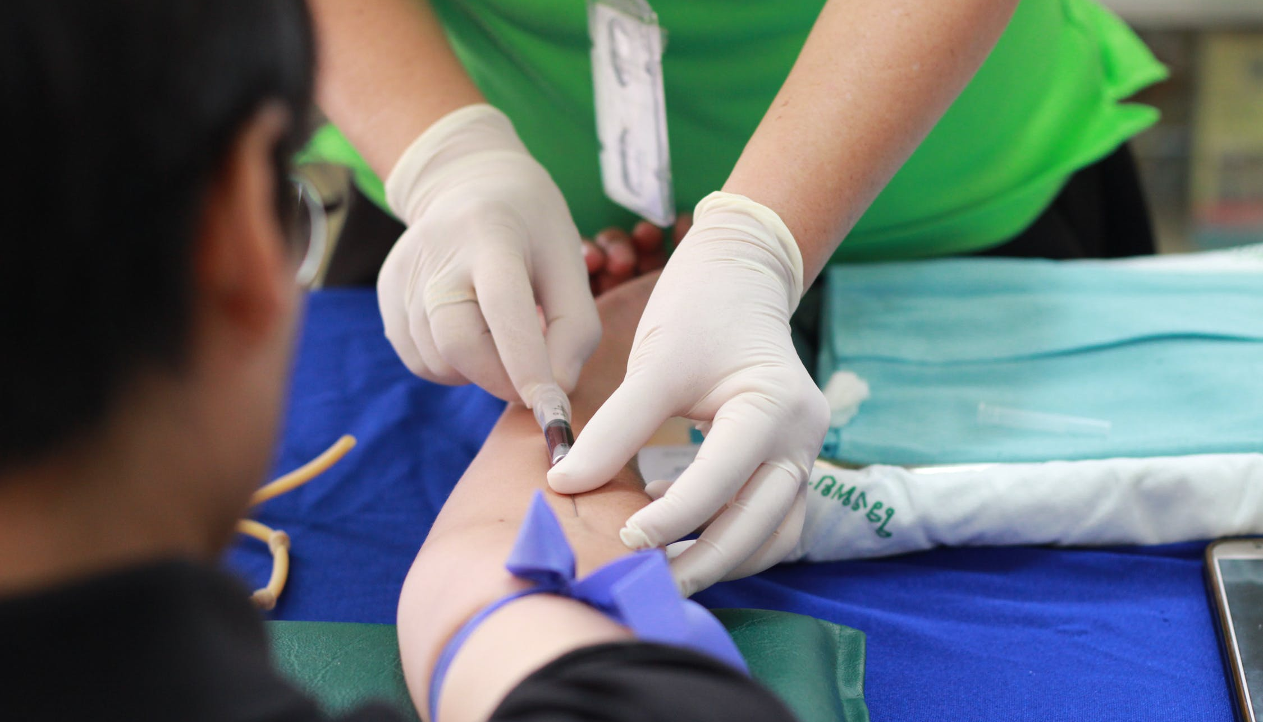
Universal Precautions
Notes:
Photo credit https://www.pexels.com/photo/person-getting-his-blood-check-1350560/
Universal precautions reference: Hodas GR. Responding to childhood trauma: The promise and practice of trauma informed care. Pennsylvania Office of Mental Health and Substance Abuse Services. 2006 Feb;177.

Slide 25
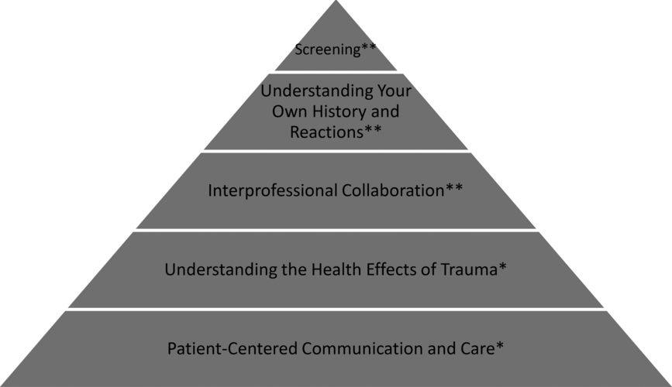
Health & Social Service Workers
Notes:
As individual care providers, we can take steps within the systems we operate in.
Interpersonal collaboration: list of resources/making referrals
Understanding health effects: increased suicidal ideation and attempts, PTSD, maladaptive coping (this applies to other domains e.g. social effects of trauma)
Person centred care: MEET PEOPLE WHERE THEY ARE AT; harm reduction; what can i do to make this more comfortable; tell people what you do before you do it; give people control over setting; make it clear people can say no/stop encounter at any time; offer predictable schedule/encounter; non-judgmental approach; allow for missed appointments etc
Raja S, Hasnain M, Hoersch M, Gove-Yin S, Rajagopalan C. Trauma informed care in medicine: current knowledge and future research directions. Family & community health. 2015 Jul 1;38(3):216-26.
And also advocacy - for individuals, and to change systems.

Slide 26
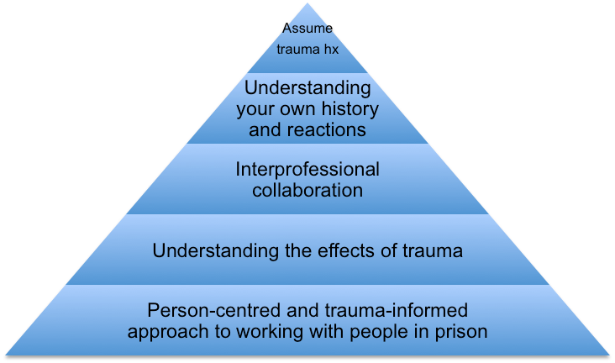
Correctional Service Workers
Notes:
As individual correctional officers, we can take steps within the systems we operate in.
Rather than screening (which you only want to do if it will result in consistent, appropriate trauma informed care), can work from baseline “gentle assumption” that people have trauma history
Interpersonal collaboration: list of resources/making referrals
Understanding effects/how it shows up in detention (explosive behaviour in response to triggers, ongoing substance use, difficulty with change to routine)
Person centred care: MEET PEOPLE WHERE THEY ARE AT; harm reduction; what can i do to make this more comfortable; tell people what you do before you do it; give people control over setting; allow people to say no (and honour this); offer predictable schedule/encounter; non-judgmental approach
Adapted from Raja S, Hasnain M, Hoersch M, Gove-Yin S, Rajagopalan C. Trauma informed care in medicine: current knowledge and future research directions. Family & community health. 2015 Jul 1;38(3):216-26.
And also advocacy - for individuals, and to change systems.

Slide 27
Conclusions
About half of people in prison experienced abuse in childhood.
We need to do more research to better understand how childhood abuse affects the risk of imprisonment.
We need to provide trauma-informed care for this population while in prison and in the community.

Slide 28
Questions?
Thank you for your attention.
For more information:
see the full publication in the American Journal of Public Health, https://ajph.aphapublications.org/doi/abs/10.2105/AJPH.2018.304855
contact us:
Claire Bodkin- claire.bodkin@medportal.ca
Fiona Kouyoumdjian- kouyouf@mcmaster.ca

Slide 29
ADDITIONAL SLIDES

Slide 30
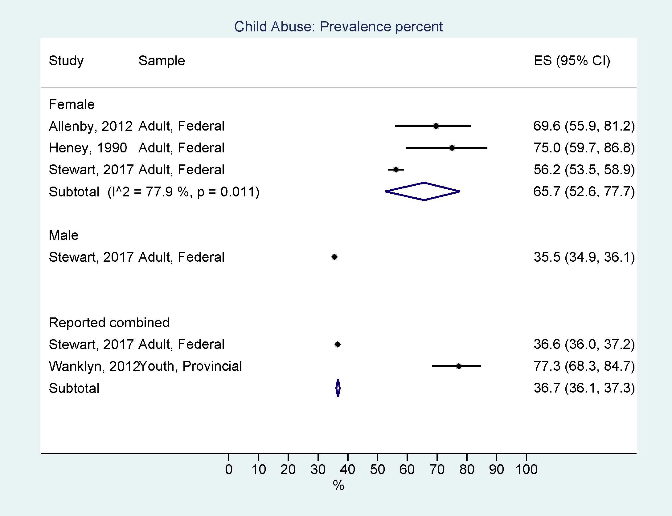
Any childhood abuse

Slide 31
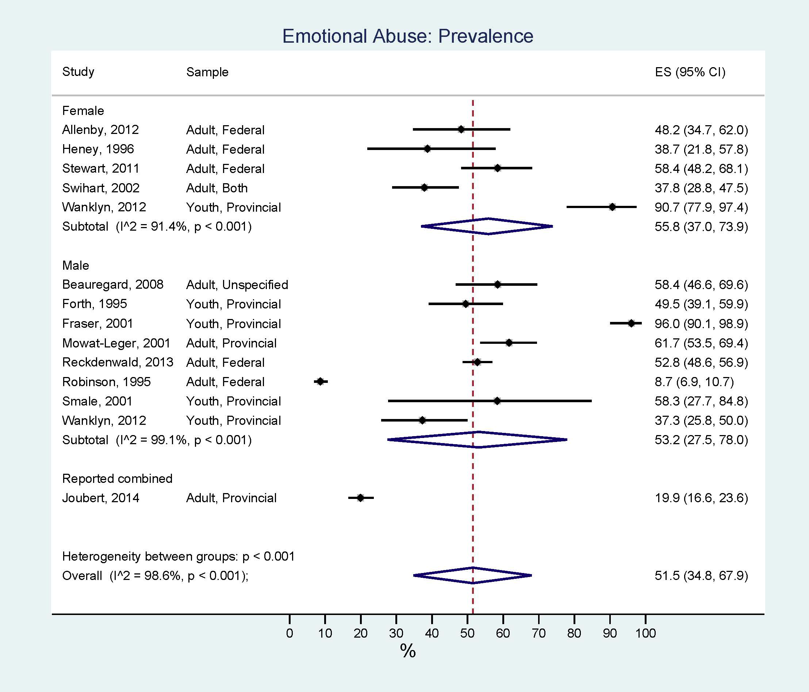
Childhood emotional abuse

Slide 32
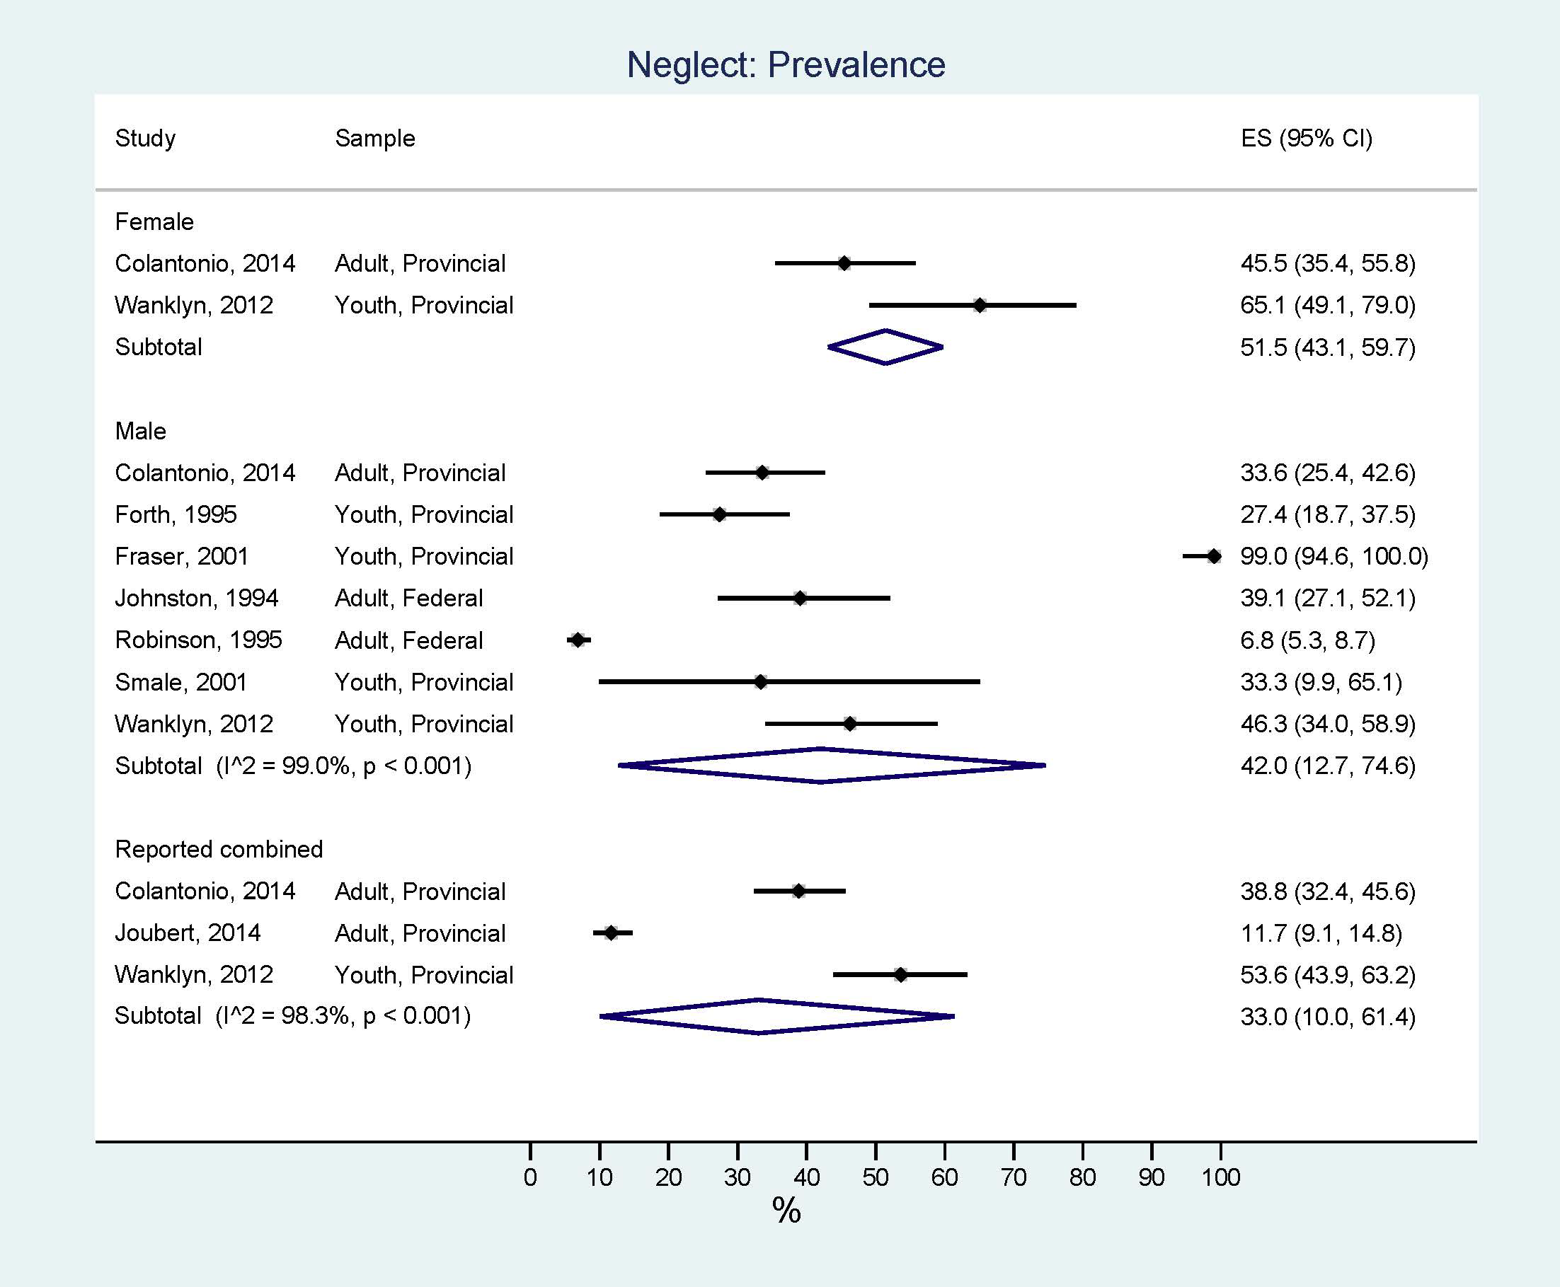
Childhood neglect

