Slide 1


P-HSJCC Webinar Series:
Dementia and the Justice System
June 21, 2018
Moderator: Tasha Rennie
Network Engagement and Communications Officer, HSJCC Secretariat

Slide 2
HSJCC Webinars
We will pause for key chat pod reflections following each section. Furthermore, we will hold a Q&A period at the end of our webinar. To ask a question, please type your question in the chat box.
The power-point presentation will be available following the webinar.
Please complete the brief evaluation survey following the webinar.
Notes:
Trevor

Slide 3
About the HSJCC Network
HSJCC Network is comprised of:
  39 Local HSJCCs
  14 Regional HSJCCs
  Provincial HSJCC
Each HSJCC is a voluntary collaboration between health and social service organizations, community mental health and addictions organizations and partners from the justice sector including crown attorneys, judges, police services and correctional service providers.
Notes:
Trevor

Slide 4
Collaborators for Today’s Presentation
Cathy Conway, Director, Education Programs, Alzheimer Society of Ontario
Krista Schneider, Regional Coordinator, Erie St Clair BSO
Monica Bretzlaff –Behavioural Supports Ontario
Sarah Denton – Behavioural Supports Ontario
Katelynn Viau – Behavioural Supports Ontario
Notes:
Trevor

Slide 5



Dementia & Justice System
June 21, 2018
HSJCC Webinar

Slide 6


Our Vision: A world without Alzheimer's disease and other dementias
Our Mission: To alleviate the personal and social consequences of Alzheimer's disease and other dementias and to promote research
MANDATE: Older with, or at risk for, responsive behaviours associated with dementia, complex mental health, substance use, and/or other neurological conditions. Inclusive in this mandate are adults with age-related neurocognitive conditions (such as early onset dementia) and specialized support for family and professional care partners.
VALUE STATEMENT: “Together we value individuality, integration and innovation”

Slide 7

Introductions
Dementia statistics, what is Responsive Behaviour?
  Krista Schneider
Dementia and Justice System statistics
  Monica Bretzlaff
Case Studies
  Sarah Denton
Areas of Focus and Potential Solutions
  Katelynn Viau

Slide 8
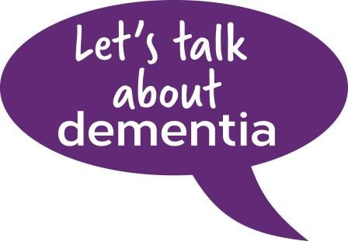
Dementia foundations &
Responsive Behaviours
Krista Schneider

Slide 9


Chat Pod reflection
“Having completed this brief segment on dementia and responsive behaviours, please describe opportunities that may exist within the justice sector to enhance knowledge and build capacity in this area?”

Slide 10
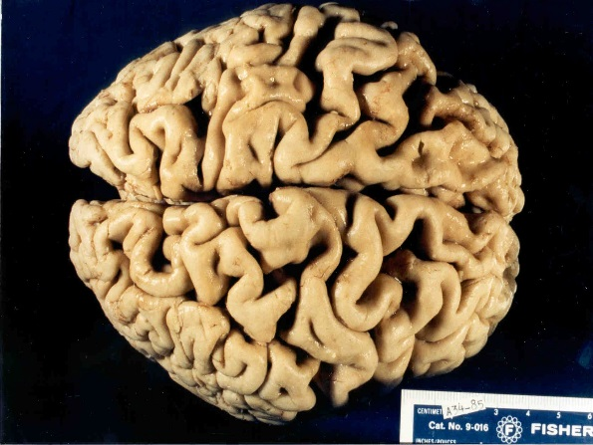
What is dementia?
A set of symptoms that occur when the brain is affected by certain diseases or conditions
Symptoms may include changes in:
  Memory
  Thinking
  Concentration
  Judgment
  Problem solving
  Functioning – all of which affect a person’s ability to perform normal daily activities.

Slide 11
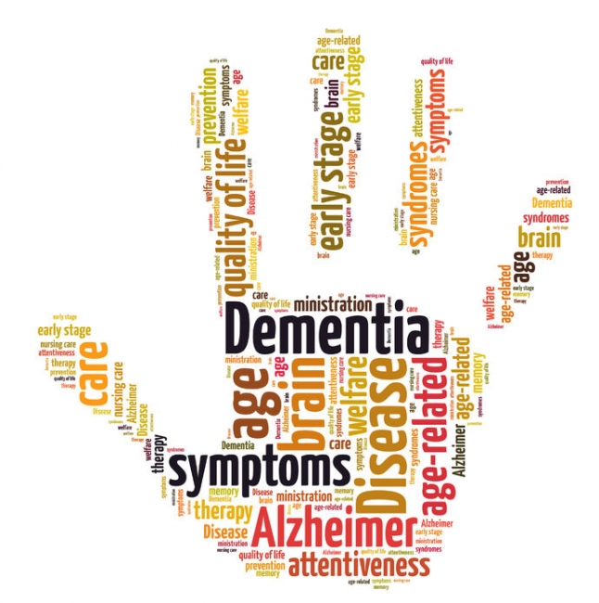
Dementia Statistics
In 2016 -- 546,000 Canadians were estimated to be living with some form of dementia or cognitive impairment
Currently, there are over 230,000 older adults in Ontario (65+) estimated to be living with some form of dementia
  This number is expected to increase by 13% to nearly one quarter of a million people by 2020.

Slide 12
Dementia Statistics
In 2013 – 99,330 Ontarians (40+) living in the community (not including long-term care) were living with a diagnosis of dementia, an increase of more than 40% since 2007
In 2013 – almost 60% of community-dwelling Ontarians with a diagnosis of dementia were women
In 2013 – the median age of community-dwelling Ontarians with dementia was 81 years old

Slide 13
Dementia Statistics
Under 65
While the risk for dementia increases with age, 2-10% of people with dementia are below the age of 65
In 2013 -- more than 8,900 community-dwelling Ontarians between the ages of 40 and 65 were living with a diagnosis of dementia (9.0% of the total community-dwelling population)

Slide 14
What is a Responsive Behaviour?
Responsive behaviours is a term that is often preferred by persons living with dementia, mental health, substance use and/or other neurological disorders to describe how their actions, words and gestures are a response to something important in their personal, social or physical environment (Alzheimer Society of Ontario, 2014).
These behaviours are often a result of changes in the brain affecting memory, judgement, orientation and mood.
Responsive behaviour indicates a change in a person’s baseline behaviour.

Slide 15
Chat Pod reflection
“Having completed this brief segment on dementia and responsive behaviours, please describe opportunities that may exist within the justice sector to enhance knowledge and build capacity in this area?”

Slide 16

Dementia and Justice System statistics
Monica Bretzlaff

Slide 17
Chat Pod reflection
“What types of quantitative and/or qualitative data may be helpful to collect in order to advocate for enhanced supports and system improvements?”

Slide 18
Dementia and Justice System Statistics
The type of incident varies, but according to a study published January 2015 in JAMA Neurology, more than a third of people with frontotemporal dementia (FTD) act out criminal behaviors.
The study raises questions about how the criminal justice system should handle people with FTD and, even more pressingly, concerns about the plight of undiagnosed patients who may be languishing in prisons or on the streets.
Source: http://www.alzforum.org/

Slide 19
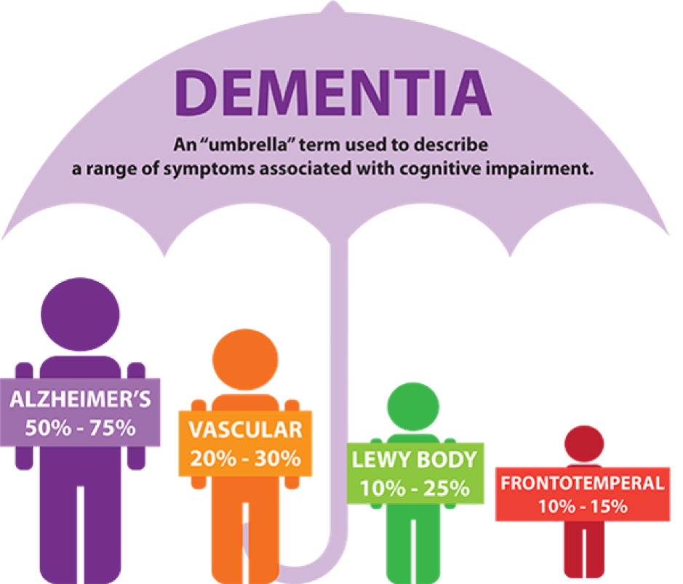
Criminal Behavior in Frontotemporal Dementia
and Alzheimer Disease
Criminal behaviours emerge in individuals with no history of antisocial activities and have been observed in patients with a variety of neurocognitive illnesses, including Alzheimer disease (AD), Frontotemporal dementia (FTD), semantic variant of Primary Progressive Aphasia (svPPA), Huntington disease (HD), Human Immunodeficiency Virus–related dementia, and Substance-induced dementia.
The crimes committed by people with dementia range from theft, traffic violations with or without the influence of alcohol, violence, hypersexuality and homicide.

Slide 20
Criminal Behavior in Frontotemporal Dementia
and Alzheimer Disease
Of 2397 patients in the study, 204 (8.5%) had behaviours that could be interpreted as criminal. The major diagnostic groups included FTD (n = 64), PPA (n = 24) AD (n = 42), and HD (n = 6)
19.9% of patients with FTD were reported to the police for criminal behaviour
https://jamanetwork.com/journals/jamaneurology/fullarticle/2088872
Madeleine Liljegren, MD; Georges Naasan, MD; Julia Temlett, MBBS; David C. Perry, MD; Katherine P. Rankin, PhD; Jennifer Merrilees, PhD; Lea T. Grinberg, MD, PhD; William W. Seeley, MD; Elisabet Englund, MD; Bruce L Miller, MD

Slide 21
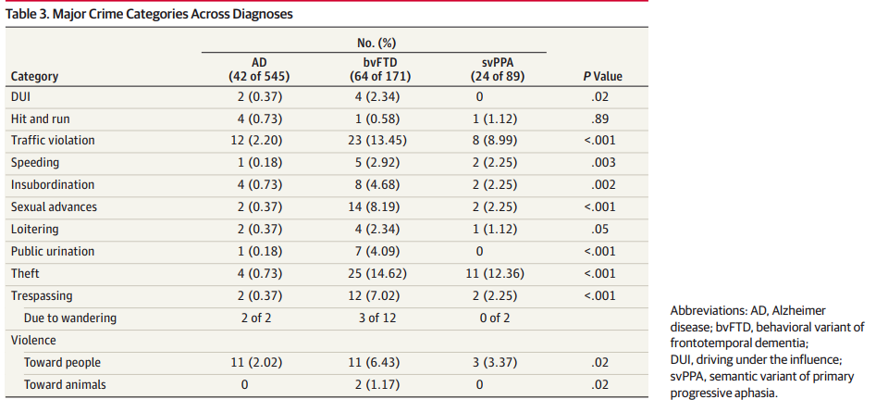
Crime Categories Across the Diagnostic Spectrum

Slide 22
Other Points to Consider
Long –term Care Homes (LTCH’s) required to contact police if they feel a violation of the criminal code has occurred.
    Interpretation
    Implications
    Predictors and prevention
Charges- discretion
    Seriousness of offence
    Circumstances leading to offence
    Can alternative solutions be explored?
Source: Wahl, Judith A, Advocacy Centre for the Elderly. When Worlds Collide: Unravelling the Issues when individuals living with dementia intersect with the Criminal Justice System, 2014

Slide 23
Other Points to Consider
Domestic violence- charges laid, perpetrator removed from the home of the victim. What does this mean for someone with a dementia and responsive behaviour who is living with their primary care partner? What does this mean for the care partner?
Source: Alstrom, Corinne. Dementia and policing: Developing Best Practices for Law Enforcement. 2013.

Slide 24
Chat Pod reflection
“What types of quantitative and/or qualitative data may be helpful to collect in order to advocate for enhanced supports and system improvements?”

Slide 25

Case Studies
Sarah Denton

Slide 26
Chat Pod reflection
“Do these case studies resonate with your clinical experiences?”
“What additional resources could have been of benefit in redirecting these cases away from the justice sector?”

Slide 27
Case Study A
John is a 70y/o male who presents to acute care from the community following an episode of verbal and physically responsive behaviours which have left his family fearing their safety.
Family share a history of violence with prior contacts with police. There is a current restraining order preventing contact with his spouse.
Diagnosis of a major neurocognitive disorder, vascular type.
Notes:
While recognizing that older adults will interface with the legal system for a variety of reasons, we thought we’d share several real life examples of cases were BSO has been involved.
Our hope is that these cases will be reflective of your own experiences and stimulate your thinking as to potential solutions and areas of opportunity to support these individuals both through proactive approaches and more reactive ones.

Slide 28
Case Study B
Gary is a 65y/o male with a substance induced neurocognitive impairment. He currently resides in LTC and had been exhibiting wandering behaviours.
There was an unwitnessed incident where it is believed Gary exhibited physically responsive behaviours resulting in injuries to his roommate. The roommate later succumbed to his injuries in hospital.
Police were involved to investigate further and to determine the potential for criminal charges, at the time of the referral to BSO.

Slide 29
Case Study C
Glenn is a 75y/o male who first came into contact with police following an incident of physically responsive towards his spouse in the community. The police officer who attended the home pressed charges. Following, Glenn was brought into custody.
During his presentation to court, he came into contact with a court worker, who in meeting with Glenn and his family suspected an potential underlying neurocognitive impairment, Alzheimer’s type and reached out to BSO.

Slide 30
Case Study D
Mary is a 82y/o female with frontal impairments currently residing in LTC. Her spouse resides in the community.
She has been routinely approaching a male resident seeking contact and has been found in his room disrobed and more recently engaging in sexual contact.
Both residents have cognitive impairments, the male resident to a lesser degree. Mary’s spouse is quite upset by these behaviours had has threatened legal action if the long term care home does not address the situation.

Slide 31
Case Study E
Omar is a 78y/o gentleman with a suspected cognitive impairment who was born and raised in a male dominant culture.
He exhibited sexually expressive behaviours on more than one occasion towards a member of the public resulting in police involvement.
Case was presented at a local First Response Strategy Table at which BSO is an active participant.

Slide 32
Chat Pod reflection
“Do these case studies resonate with your clinical experiences?”
“What additional resources could have been of benefit in redirecting these cases away from the justice sector?”

Slide 33

Areas of Focus and
Potential Solutions
Katelynn Viau

Slide 34
Chat Pod reflection
“For each promising practice identified, which key players do we need to engage in collaborative planning next steps?”

Slide 35
Prevention Strategies & Reactive Approaches
System Coordination/ Management | Integrated Service Delivery: Intersectoral/ Interdisciplinary | Knowledgeable Teams & Capacity Building
Older Adult Liaison Committee, Rapid Mobilization Tables Focused discussion table where participants collaboratively identify situations of acutely elevated risk. Once a situation is identified, all necessary agency partners participate in a coordinated, joint response – ensuring that those at risk are connected to appropriate, timely, effective and caring supports | Care Pathway Development between relevant Community Providers: Coordinated response and process to assist persons with dementia and their care partners who are experiencing behaviours that may result in a criminal offence Specialized Geriatric Law Enforcement Team: Concept of having all Police Officers trained in “Dementia Basics” (see column 3) but also having a Geriatric Intervention Team made up of Police Officers who would respond to calls whereby specific intervention skills and knowledge of dementia would be required. | Education/Training Program containing the following components: About Dementia Situations whereby Police Officers may come into people with people living with Dementia Distinguishing Dementia vs. other conditions using relevant tools (especially delirium) Communication Strategies Responsive Behaviours Engagement with Community Resources

Slide 36

What Role might BSO play in each of these promising practices?
System Coordination/ Management | Integrated Service Delivery: Intersectoral/ Interdisciplinary | Knowledgeable Teams & Capacity Building
Older Adult Liaison Committee, Rapid Mobilization Tables, Start Hubs: | Care Pathway Development between relevant Community Providers: Specialized Geriatric Law Enforcement Team: | Education/Training Program containing the following components:
BSO as part of the process pathway facilitating integrated response as appropriate.
Having BSO Clinicians be members of these tables; having the expertise and availability to become involved in a timely manner when appropriate.
Psychogeriatric Resource Consultants (PRCs) aligned with BSO across the province provide education and other capacity building activities to providers across sectors.

Slide 37
Chat Pod reflection
“For each promising practice identified, which key players do we need to engage in collaborative planning next steps?”

Slide 38

Questions & Discussion

