Slide 1

P-HSJCC Webinar Series:
Traumatic Brain Injury and the Justice System
January 10, 2019
Moderator: Tasha Rennie
About today’s webinar:
We will have a Q&A period at the end of our webinar. To ask a question, please type your question in the chat box.
This webinar will be recorded. The recording and power-point presentation will be emailed to you following the webinar.
Please complete the brief evaluation survey following the webinar.
About the HSJCC Network:
The Human Services and Justice Coordinating Committee (HSJCC) Network is comprised of: 39 Local Committees, 14 Regional Committees, and one Provincial HSJCC
Each HSJCC is a voluntary collaboration between health and social service organizations, community mental health and addictions organizations and partners from the justice sector including crown attorneys, judges, police services and correctional service providers.

Slide 2
Traumatic Brain Injury and the Justice System
Human Services and Justice Coordinating Committee Webinar
January 10, 2019
Flora Matheson Ph.D
Catherine Wiseman-Hakes Ph.D
Angela Colantonio Ph.D

Slide 3
Brain Injury among Criminal Justice Populations: Session Overview
Our research: Traumatic Brain Injury, Mental Health and Addictions in Vulnerable Populations
Incorporating Sex and Gender into work and research; What does this mean and why is it important?
Traumatic Brain Injury and the Criminal Justice System; What we know & current research program
How can you be involved?

Slide 4

Integrating Brain Injury, Mental Health, and Addictions
Colantonio, A. (PI). Chan, V. Mann. R., Balogh, R., Kirsh, B., Nalder, E., Kontos, P., Wiseman-Hakes, C., Matheson, F., Riopelle, R., Grigorovich, A., Haag, L.
Funding by
4
Notes:
Angela

Slide 5
Project Goal
To facilitate the integration of services for men and women with traumatic brain injury (TBI) and mental health and/or addiction (MHA), by addressing relevant knowledge gaps about TBI and MHA, promoting meaningful cross-sectoral engagement with decision makers through research and knowledge translation activities.
Explicit consideration of sex and gender throughout
5
Notes:
Angela

Slide 6

Generously Supported By
6
Notes:
Angela

Slide 7










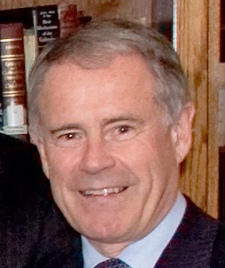

Research Team
Angela Colantonio
Principal Investigator
University of Toronto
angela.colantonio@utoronto.ca
Emily Nalder
Co-Investigator
University of Toronto
emily.nalder@utoronto.ca
Catherine Wiseman-Hakes
Co-Investigator
University of Toronto
catherinew.hakes@utoronto.ca
Vincy Chan
Co-Investigator
Toronto Rehabilitation Institute-UHN
vincy.chan@uhn.ca
Bonnie Kirsh
Co-Investigator
University of Toronto
bonnie.kirsh@utoronto.ca
Pia Kontos
Co-Investigator
Toronto Rehabilitation Institute-UHN
pia.kontos@uhn.ca
Robert Balogh
Co-Investigator
University of Ontario Institute of Technology
robert.balogh@uoit.ca
Flora Matheson
Co-Investigator
St. Michael’s Hospital
mathesonf@smh.ca
Alisa Grigorovich
Co-Investigator
Toronto Rehabilitation Institute-UHN
alisa.grigorovich@uhn.ca
Robert Mann
Co-Investigator
Centre for Addiction and Mental Health
robert.mann@camh.ca
Halina (Lin) Haag
Co-Investigator
Wilfrid Laurier University
hhaag@wlu.ca
Richard Riopelle
Co-Investigator
Ontario Neurotrauma Foundation
richard.riopelle@mcgill.ca
7
Notes:
Angela

Slide 8
Research Team
Danielle Toccalino
Research Assistant
University of Toronto
danielle.toccalino@mail.utoronto.ca
Hyun (Jeff) Ryu
Research Assistant
St. Michael’s Hospital
hyun.ryu@mail.utoronto.ca
Lindsay Rideout
MScOT Trainee
Occupational Sciences & Occupational Therapy
University of Toronto
Kristin Dobranowski
Research Assistant
University of Ontario Institute of Technology
kristin.dobranowski@uoit.ca
Danielle Burlie
MScOT Trainee
Occupational Sciences & Occupational Therapy
University of Toronto
Alexandra Saffran
MScOT Trainee
Occupational Sciences & Occupational Therapy
University of Toronto
Gina Stoduto
Research Coordinator
Centre for Addiction and Mental Health
gina.stoduto@camh.ca
Sonia John
MScOT Trainee
Occupational Sciences & Occupational Therapy
University of Toronto
Mijal Vonderwalde
MScOT Trainee
Occupational Sciences & Occupational Therapy
University of Toronto
Jen Estrella
Research Assistant
University of Toronto
majennifer.Estrella@mail.utoronto.ca
Lauren Marcus
MScOT Trainee
Occupational Sciences & Occupational Therapy
University of Toronto
Samira Omar
PhD Trainee
Rehabilitation Sciences Institute
University of Toronto
8
Notes:
Angela

Slide 9

Program Advisory Committee (PAC): Membership
A key component of this Research Program is the promotion of meaningful cross-sectoral engagement with knowledge users, including persons with lived experience, caregivers of persons with lived experience, and service providers through collaboration and participation in research and knowledge translation and exchange (KTE) activities.
Additional members may be recommended at any time
9
Notes:
Angela

Slide 10

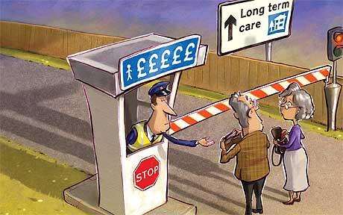

Research Program Objectives & Anticipated Outcomes
Aim 1 (Policy-Relevant Data): Impact of concurrent TBI and MHA on system level outcomes
Policy-relevant
population-based data
Aim 2 (Policy-Relevant Data): Barriers and facilitators to accessing health services
Equitable access to
healthcare
Aim 3 (Housing): Critical characteristics of housing support
Design of appropriate
housing models and KT materials
Aims 4a (Criminal Justice/Legal System) & 4b (IPV): Gaps in knowledge and practice among front-line staff/first responders, service providers, and decision-makers regarding
criminalized men and women, and
women survivors of IPV
Creation and evaluation of relevant education and KT materials
Integration of sex and gender throughout
10
Notes:
Angela

Slide 11


Incorporating Sex and Gender in Work and Research
11
Notes:
Angela

Slide 12
What is ‘Sex’ and ‘Gender’?
Sex
Gender
Typically refers to “…the biological and physiological characteristics that distinguish males from females”
Typically refers to the “…socially constructed roles, relationships, behaviours, relative power, and other traits that societies ascribe to women and men”
Although sex (male/female) and gender (men/women) are both commonly discussed as discrete and binary concepts, CIHR acknowledges that both are fluid and dynamic
Sex and gender are interrelated; the relationships are complex
(CIHR, 2010)
12
Notes:
Angela

Slide 13
Traumatic Brain Injury in the Criminal Justice System: What We Know
Notes:
Flora

Slide 14
Brain Injury among Criminal Justice Populations: What We Know
In lay terms, Traumatic Brain Injury (TBI) is defined as a blow or jolt to the head or a penetrating head injury, which disrupt the function of the brain either temporarily or permanently. (CDC Brainline.org)
TBI falls under the umbrella of Acquired Brain Injury (ABI). ABI includes TBI and non traumatic brain injuries such as stroke, aneurysm, and anoxia.
Concussion is also a TBI and is defined as a traumatically induced temporary disturbance of brain function. Current evidence suggests that there may be some longer term alterations in brain function associated with concussion in some individuals. Concussion can occur (and often does) without a loss of consciousness.
A person does not need to hit their head for a TBI of any severity to occur.
Those with TBI (including concussion) are at higher risk of sustaining another, and, a history of multiple TBI’s is associated with slower recovery.
Common causes of TBI include falls, motor vehicle crash, assaults and domestic violence, sports injuries.
Notes:
Flora

Slide 15
Brain Injury among Criminal Justice Populations: What We Know
Traumatic brain injury (TBI) is highly prevalent among jail and prison inmates and those who have come into contact with the criminal justice system.
As many as 100% of incarcerated adults have a reported history of TBI. (Durand et al., 2017)
For youth, the rate is estimated from 16-72%. (Hughes et al., 2015; Wszalek & Turkstra, 2015)
Adverse early life experiences are common for persons with a history of TBI and incarceration particularly for criminalized women. (Colantonio et al., 2014)
Previous work by Dr. Matheson’s lab identified that in Ontario, men and women who sustained a TBI were about 2.5 times more likely to be incarcerated than men and women who had not sustained a TBI. (McIsaac et al., 2016)
        Recent findings indicate that people with TBI are 14 times more likely to incur a serious charge and 12 times less likely to achieve discretionary release.
Notes:
Flora

Slide 16

Brain Injury among Criminal Justice Populations: What We Know
Having a history of diagnosed TBI and/or repeated hits to the head neck or face increases the risk of recidivism by 69%. (Ray et al., 2017)
Violence is both a cause and sequelae of TBI.
These prevalence rates are so significant that the U.S. Centers for Disease Control and Prevention (CDC) have identified TBI among prisons and jails as a significant public health problem. (CDC Brainline.org)
Notes:
Flora
NOTE: The Ray 2017 study used the OHIO for screening for TBI and do not indicate severity levels.

Slide 17
Traumatic Brain Injury: Cognition, Communication and Behaviour
Notes:
Catherine

Slide 18
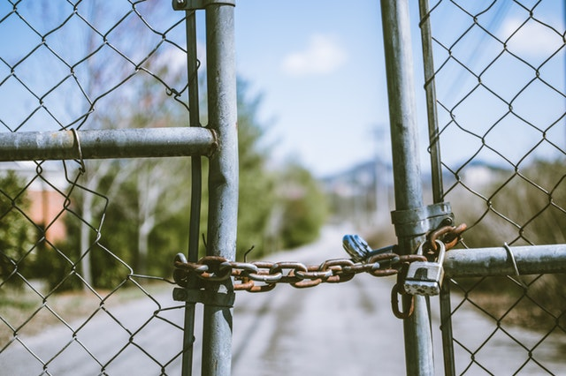
Brain Injury among Criminal Justice Populations: What We Know
TBI is associated with a number of cognitive, communication, emotional and behavioral challenges that complicate management during incarceration and create barriers to successful community reintegration.
Cognitive challenges include alterations in; attention, memory, multi-tasking, self-monitoring, planning and organizing, problems solving and reasoning.
Emotional challenges may include increased lability, or reduced affect and initiation; depression is also prevalent.
Cognitive-communication refers to difficulties with any aspect of communication; listening, understanding, speaking, reading, writing and thinking, due to underlying cognitive impairments. This also includes challenges with behavioral self regulation that impact social communication.
Notes:
Catherine

Slide 19
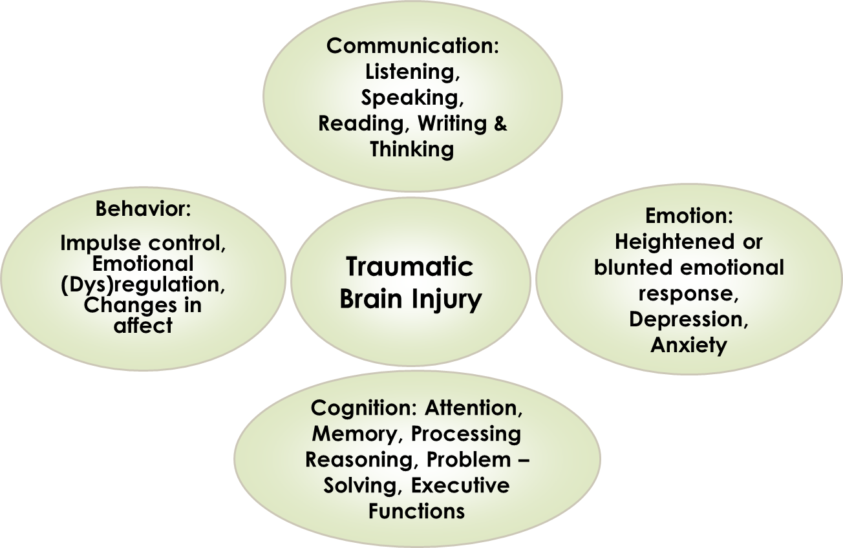
The Impact of TBI on Cognition and Communication: How We Think and How We Interact with Others
Notes:
Catherine
Impaired/reduced processing of information and conversation
Difficulty using and understanding language in a variety of situations and contexts
Difficulty expressing ideas and emotions
Challenges with impulse control and self-regulation of emotion and behavior
Challenges with social communication leading to poor social exchanges
Difficulty with reasoning and judgement and anticipating consequences: Can lead to exploitation and abuse

Slide 20

Professional Misconceptions
    All of these challenges can be misinterpreted as; (Snow & Powell, 2012)
Non compliance
Rudeness
Defiance
Poor motivation
Disengagement
Notes:
Catherine

Slide 21

Why is This Important Within the Context of Criminal Justice?
The trajectory of criminal justice i.e., from first responders to interactions with police, and front-line workers, probation and parole officers, to formal proceedings, (e.g. bail hearings, court trials) involves complex social interactions that typically require high-level and fast paced processing of information, understanding and responding. (Wszalek & Turkstra, 2015)
Notes:
Catherine

Slide 22



Brain Injury: What We Also Know
While TBI occurs across all levels of sociodemographic status, evidence suggests a strong socio-economic gradient with individuals from disadvantaged backgrounds being at greater risk. (Colantonio et al., 2014; Hwang et al., 2008; Williams et al., 2006)
We also know that the sequelae of TBI are most often superimposed on pre-existing language and literacy impairments as well as mental health, substance use and addictions challenges. (Hughes et al., 2012; Snow et al., 2012; Snow et al., 2016) These can be further exacerbated by poor sleep and poor nutrition.
Notes:
Catherine

Slide 23
Brain Injury among Criminal Justice Populations: Professional Misperceptions
There exists a general lack of awareness regarding the impact of a TBI, which results in pervasive environmental, attitudinal and information barriers which marginalizes those with TBI. (Goldblum & Alant, 2009)
This can impede effective practice.
Case workers, Front-line staff, First responders and Legal/Justice system professionals need training in identifying TBI, and, in managing, communicating with, and providing resources for those with TBI or suspected TBI in the criminal justice system.
Notes:
Catherine

Slide 24
Bridging the Gaps through Applied Research: Communication Partner Training
Currently we are conducting a qualitative research study, co-designed and co-created with community stakeholders including individuals with lived experience of TBI, with the end goal to develop staff training materials called ‘Communication Partner Training’.
This involves in-depth semi-structured interviews with service users and focus groups with staff.
The overarching aim of this research is to improve the communication experience for both the clients and staff, which may help to improve outcomes.
Notes:
Catherine

Slide 25
Bridging the Gaps through Applied Research: Communication Partner Training
What is communication partner training (CPT)?
CPT is an evidence based method of enhancing/ optimizing the communication process and the communication environment where communication partners receive specific training on how to:
  modify their communication,
  engage the person with the communication difficulty in conversation and,
  identify specific communication breakdowns and repair them.
Communication partner training programs can empower service providers to interact with greater knowledge and confidence, with individuals with TBI, which will potentially facilitate deeper participation for both parties. (Goldblum & Alant, 2009)
Notes:
Catherine

Slide 26
Bridging the Gaps through Applied Research: Communication Partner Training
Example: Communication Partner Training in the Criminal Justice System
Training communication partners of people with traumatic brain injury: A randomised controlled trial: Togher et al., 2004: Aphasiology
This study evaluated the effectiveness of a training program aimed at improving the communication of police officers during service encounters with people with TBI.
Trained police had learned strategies to successfully establish the nature of the inquiry, provide a clear answer to the inquiry and ensure appropriate leave taking, resulting in more efficient, focused interactions.
Notes:
Catherine

Slide 27
How Can You Get Involved?
27

Slide 28

Discussion
What are the training needs for members of HSJCC regarding TBI and MHA?
What types of knowledge translation materials would be most useful?
Potential opportunities

Slide 29
Resources
https://www.brainline.org/article/traumatic-brain-injury-guide-criminal-justice-professionals
http://www.abistafftraining.info/
https://www.nhchc.org/2011/03/diagnosis-treatment-traumatic-brain-injury/ (Webinar recording: Diagnosis and treatment of TBI: National Healthcare Council for the Homeless)

Slide 30
Thank You!
Any questions ?
You can contact us at
mathesonf@smh.ca
catherinew.hakes@utoronto.ca
angela.colantonio@utoronto.ca
tbistudy@smh.ca

Slide 31
Bridging the Gaps through Applied Research: Intimate Partner Violence (Aim 4B)
Knowledge & Practice Gaps Regarding Women Survivors of Intimate Partner Violence
Research Goals:
              Explore the degree of understanding of first responders about challenges experienced by brain injured women survivors of IPV
              Identify gaps in service
              Particular interest in issues related to communication
              Develop knowledge and training materials to improve interactions with first responders
31

Slide 32
Bridging the Gaps through Applied Research: Criminal Justice (Aim 4A)
Traumatic Brain Injury and the Justice System
Research Goals:
              To identify gaps in knowledge and practice among front-line staff, service providers and decision-makers regarding criminalized individuals with a TBI and MHA
              Focus on issues related to communication and communication practices
              Additional focus on sex and gender specific needs
              To create knowledge and training materials to support communication best practices for front-line workers

